Slide 1

AccountingSuite Overview
updated to ver. 2.26.8

Slide 2
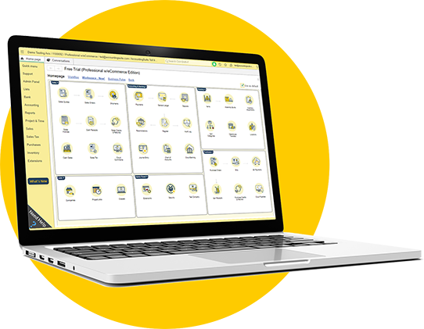
What AccountingSuite is
Software for small and medium-sized businesses which covers all activities and functions for any types of business
Outstanding benefits for companies to have a sustainable development as well as optimizing competitive advantages
Management reports are flexible and can be easily edited and customized by users to suit their purposes

Slide 3
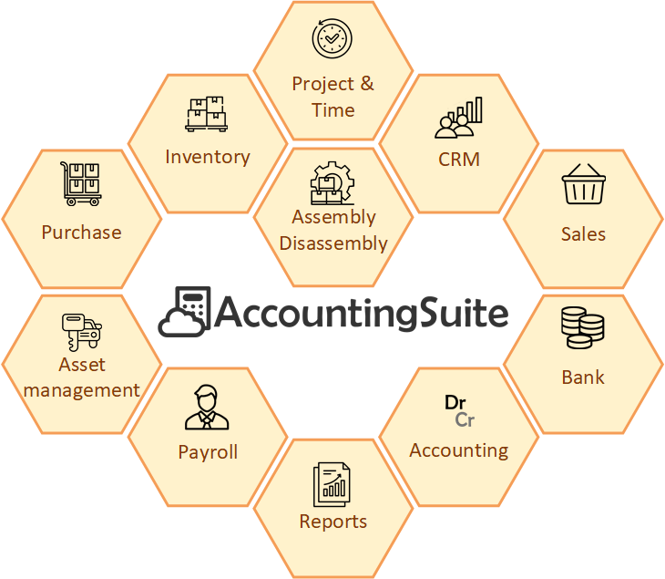
Software module scheme

Slide 4

Which companies use AccountingSuite?
Trading activities – 62%

Slide 5
Who is the target audience of AccountingSuite?
Accounting Practices & Freelance Accountants (CPA)
Small & Medium Enterprises (SMEs) – Core Users
Characteristic | Description
Profile | Independent accountants, small accounting firms, freelance CPAs managing books for multiple clients.
Business Size | 1-5 employees (the practice itself). Serves multiple SMB clients (1-50 employees each).
Industry Focus | Various (Trade, Services, Simple Manufacturing across their client portfolio).
Primary Needs | 1. Manage multiple clients’ books in one/system. 2. Easy onboarding for new clients. 3. Core accounting, invoicing, reporting. 4. Compliance with local tax regulations. 5. Affordable, predictable cost (per client or user). 6. Reliable data access (cloud crucial).
Preferred Edition | Standard (multi-entity/client support). Lite for starters or solo practitioners with few clients.
Key Decision Drivers | Cost-effectiveness per client, ease of use, reliability, local compliance features, cloud accessibility.
Characteristic | Description
Profile | Owner-managed businesses, growing companies with dedicated finance staff (1-3 accountants).
Business Size | 5-80 employees, up to ~50 concurrent software users.
Industry Focus | Wholesale & Retail Trade, Import/Export, Services (IT, Consulting, Hospitality), Simple Manufacturing/Assembly, Agriculture (post-harvest, trading).
Primary Needs | 1. Integrated financial management (GL, AP, AR, Inventory, Payroll, Assets). 2. Basic inventory & sales management for trade. 3. Simple production costing. 4. Multi-user access with role permissions. 5. Basic reporting & dashboards for decision-making. 6. Local tax and financial reporting compliance.
Preferred Edition | Standard (for service companies), Premium for those needing advanced modules (e.g., Advanced Inventory, CRM, Assets).
Key Decision Drivers | Functionality fit, total cost of ownership, scalability, ease of implementation, local support availability, data security.

Slide 6
Who is the target audience of AccountingSuite?
Growing & Larger Companies (Requiring Customization)
Characteristic | Description
Profile | Established medium-sized companies, subsidiaries of larger groups, companies with complex processes.
Business Size | 60-500+ employees, up to 300-500 concurrent software users.
Industry Focus | Distribution, Light Manufacturing, Services with multiple branches/locations.
Primary Needs | 1. Scalable system to support growth. 2. Customization to fit unique business processes. 3. Integration with other systems (CRM, e-Commerce). 4. Advanced reporting, budgeting and analytics. 5. Multi-company/consolidation support. 6. High performance with many users.
Preferred Edition | Premium + Custom Development (leveraging open 1C platform), On-Premises.
Key Decision Drivers | Flexibility/customization potential, long-term scalability, total cost vs. building a custom system, the possibility of in-house development in 1C open source code.

Slide 7

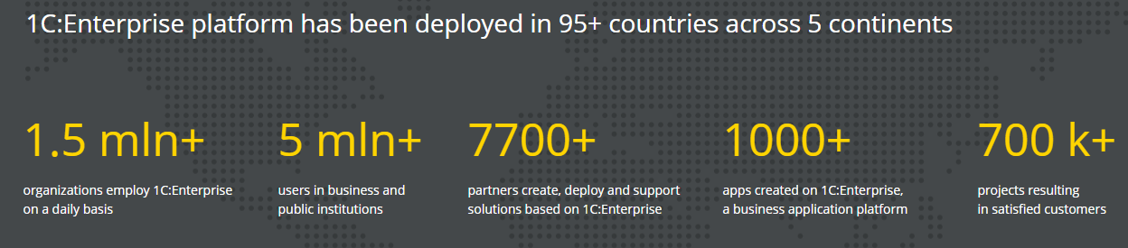
Worldwide experience
AccountingSuite was developed using the powerful 1C:Enterprise Platform
1C:Enterprise is leader in Russia and across the world with over 30 years experience in Accounting and ERP software

Slide 8


Partner
AccountingSuite
Extensions
Third-party integration
Partner’s
Applications
Vendor
AccountingSuite
Application
Other
1C Applications
1C Platform
File Mode
Database
Database Management System
(PostgreSQL, MS SQL)

Slide 9
Software features
One software for everything your company needs
Cash
Purchases
Inventory
Sales
Cash
Payroll
Accounting
Fixed assets
Financial
Tax
Management

Slide 10
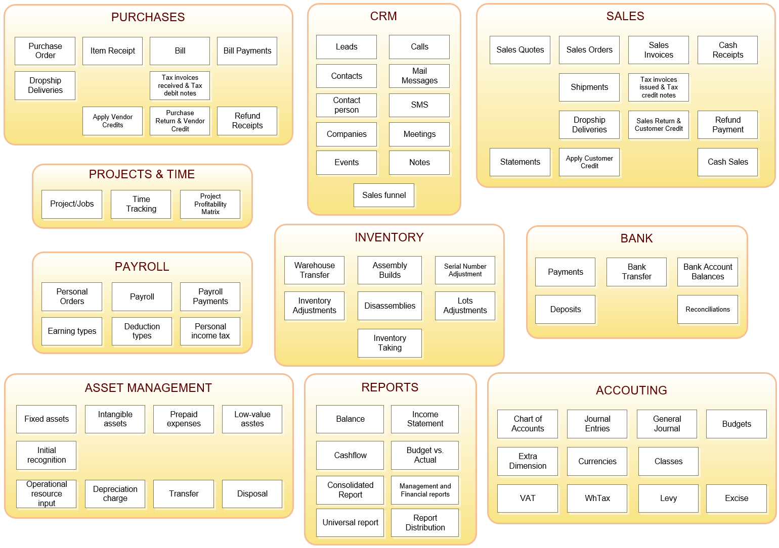

Slide 11
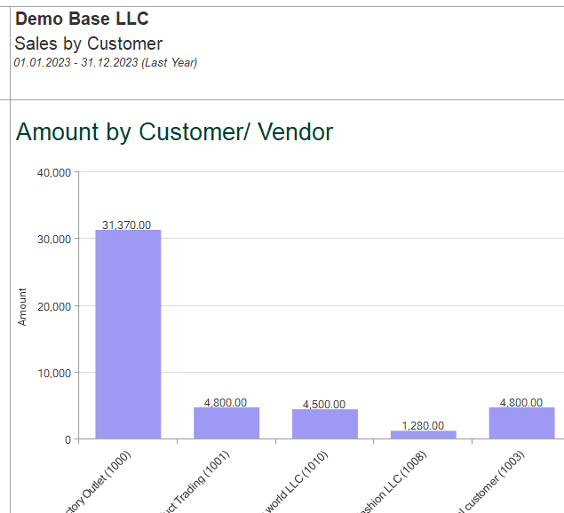
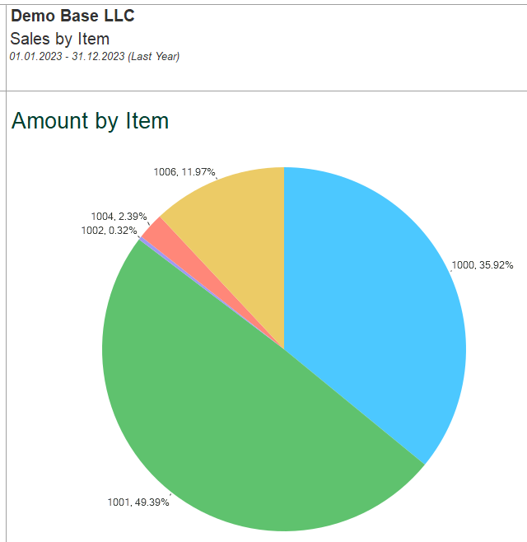
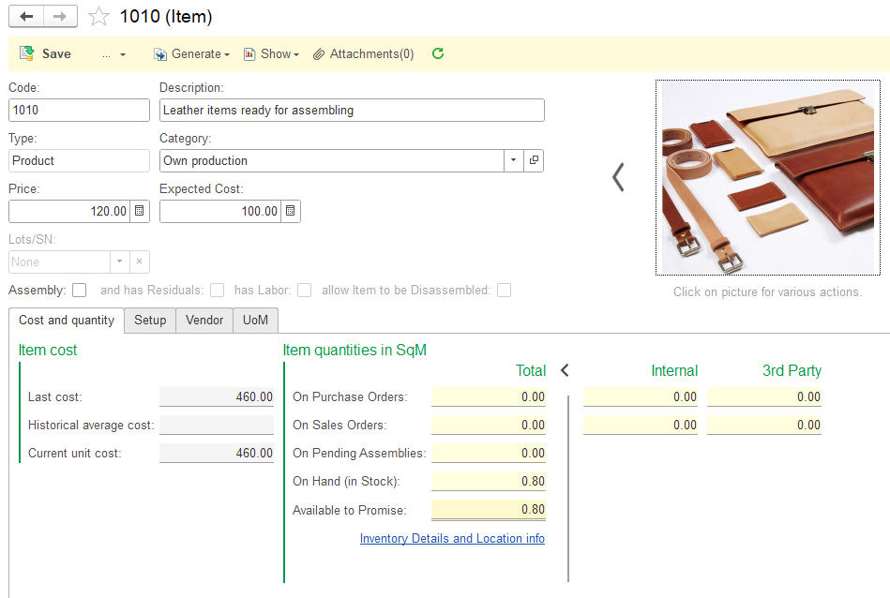
All-in-one solution to manage small or medium-sized business
AccountingSuite – what for?

Slide 12

Extensions
DEFAULT
CUSTOMIZED
Provided quickly for bug-fixes, so you do not have to wait for the new release
Customized extensions can be ordered from your provider and are designed specifically for your company’s needs
No need to modify the standard configuration

Slide 13


Customized extensions
Tailored Solutions for Your Accounting Needs
Software integrations
Complex reports
Workflow automation
Advanced analytics

Slide 14


Features: On-premise or Cloud
ON-PREMISE
CLOUD
Full control over data and infrastructure
Requires installation and maintenance of software on local servers
Suitable for organizations with strict data privacy and security requirements Performs without Internet access
Hosted on remote servers, accessible via an Internet connection
Lower upfront costs as there is no need for hardware or software purchases
Enables remote access and collaboration from any location with stable Internet access

Slide 15
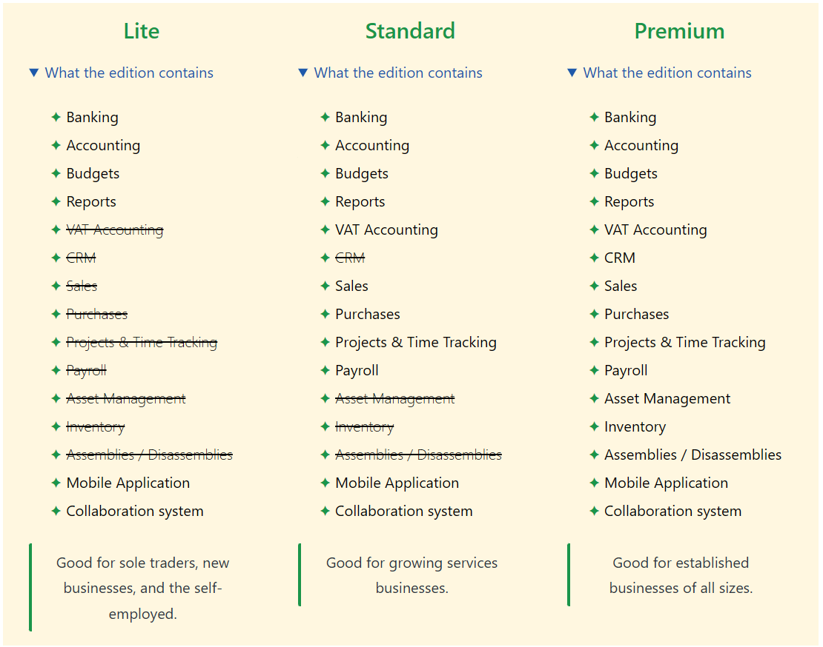
CLOUD
EDITIONS
You can easily start with just one user and Lite Edition and add more options and users as your business grows

Slide 16

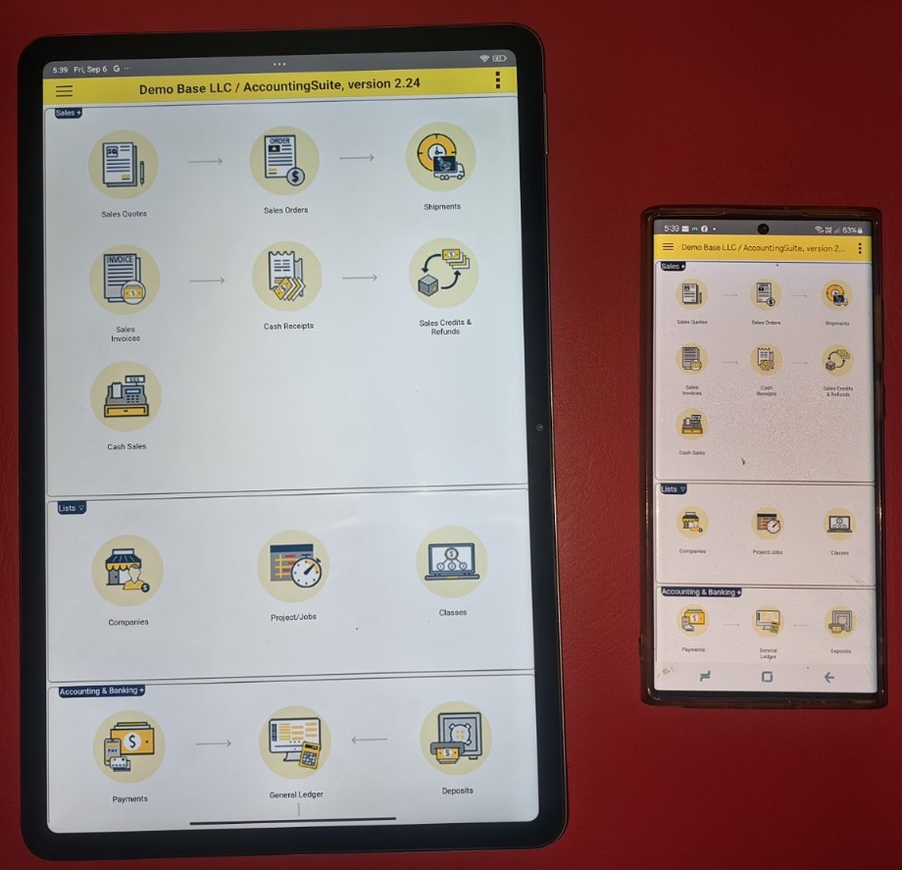


Features: Mobile application
ACCESS FINANCIAL DATA ANYTIME, ANYWHERE
Increased productivity
Responsiveness to urgent financial matters

Slide 17


Features: Real-time reports
Access the most up-to-date information and make informed decisions quickly, without having to wait for manual updates or reports
Allows for increased productivity and responsiveness to urgent financial matters

Slide 18

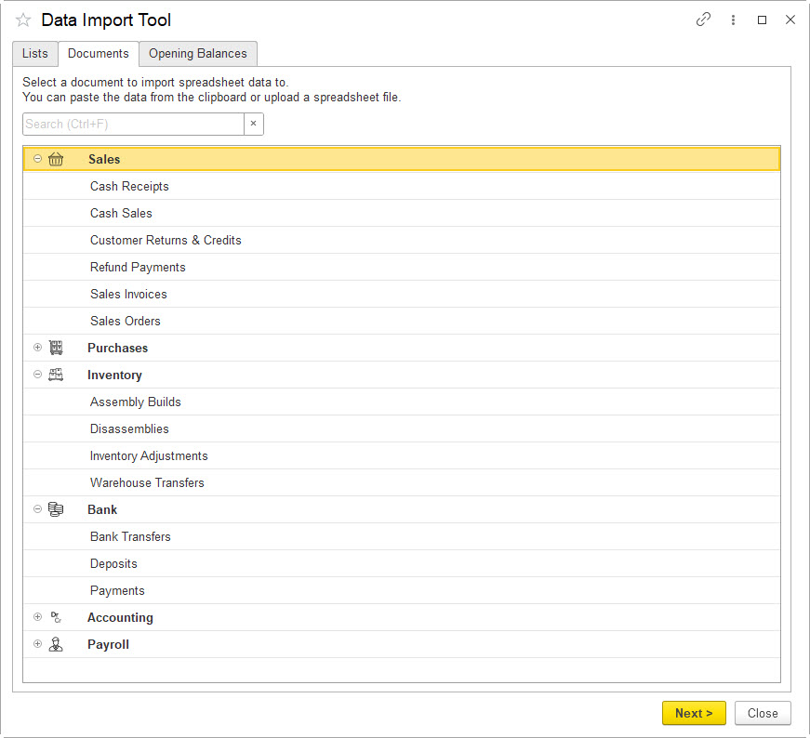
Features: Data Import Tool
Streamlines the process of migrating data from the previous system to AccountingSuite
Reduces manual data entry errors and saves time
Migrate full historical data or closing balances using CSV/XLS
Allows to customize and map data fields between systems
Preserves data integrity and accuracy during migration

Slide 19
FEATURES OVERVIEW

Slide 20
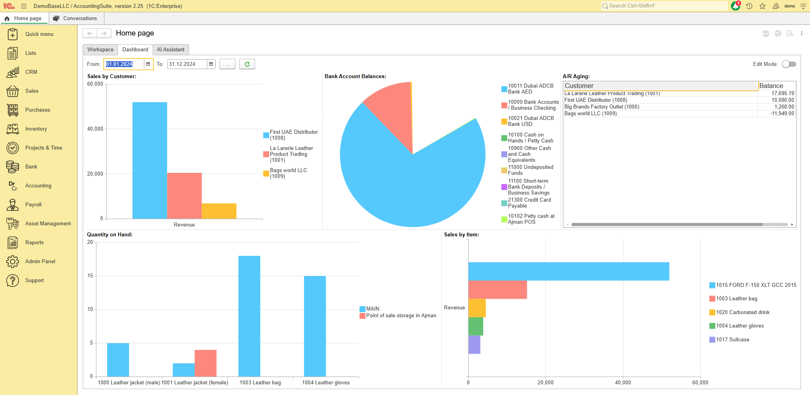
Dashboards

Slide 21
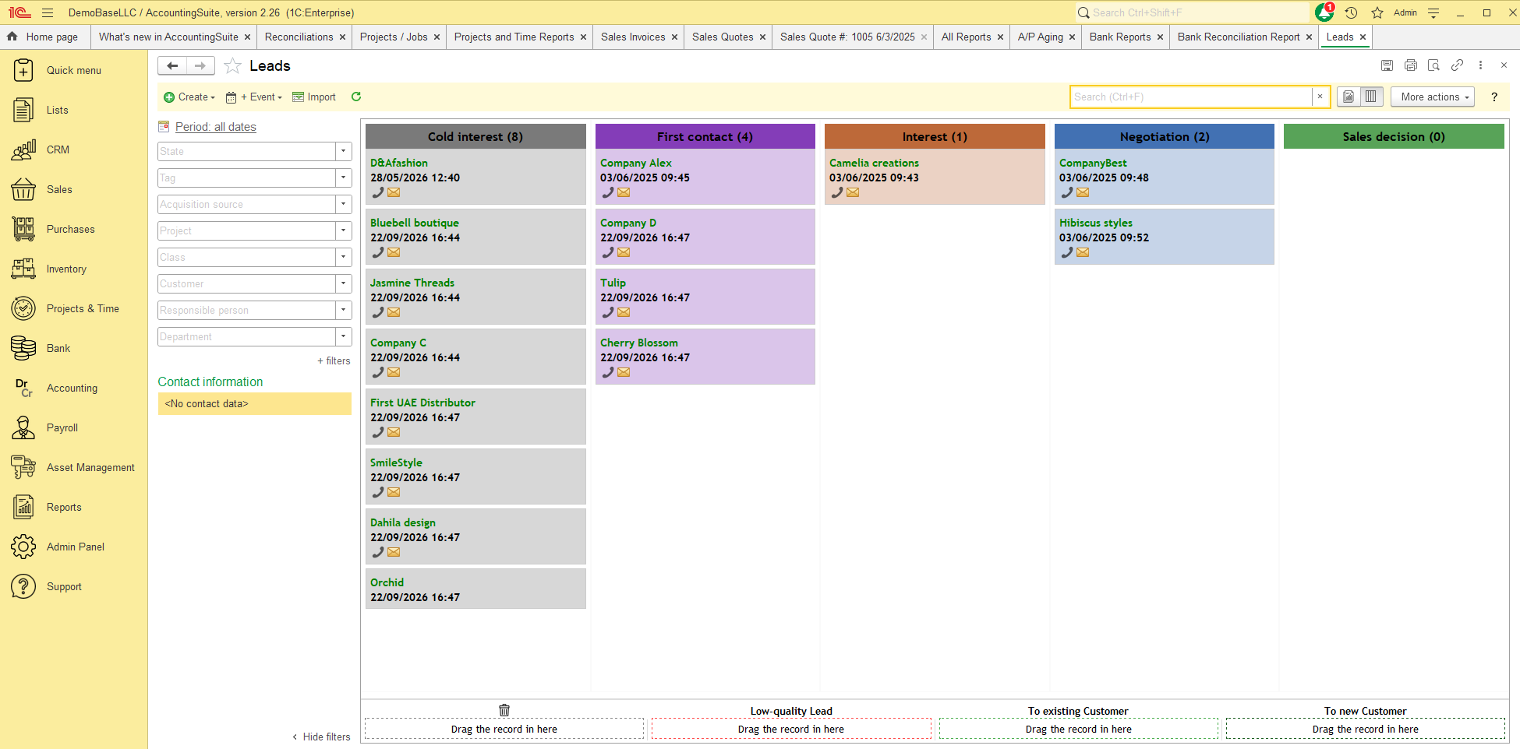
Customer Relationship Management

Slide 22


Wholesale
Sales
E-commerce
Retail
Consignment
Sales orders – Discounts – Shipping – Dropshipping- Progressive Invoicing

Slide 23

Flexible workflows
Sales
Sales Quote
Sales Order
Prepayment
Sales Invoice
Cash Receipt
Sales Order
Sales Invoice
Cash Receipt
Sales Invoice
Cash Receipt
Cash Sale

Slide 24
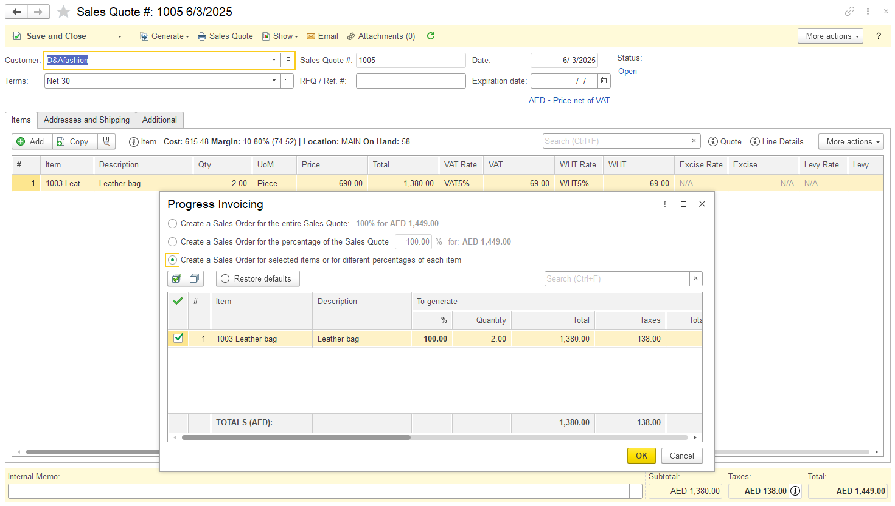
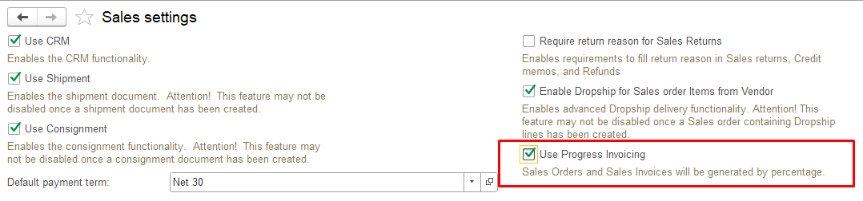
Progress Invoicing (Percentage of Completion method)
From project milestones to measured revenue

Slide 25

Ship seamless, sell effortless
Sales - Dropshipping
No obsolete inventory
DROPSHIPPER
DELIVERY
No need to worry about delivery
ORDER
CUSTOMER
Wide product range
YOUR COMPANY
ORDER
PAYMENT
Flexible location

Slide 26

Consignment shops handle the selling process for you, saving you time and effort
Consignment sales
Lower storage cost
Access a wider market of potential customers
Benefit from the expertise and marketing strategies of the consignment shop
This option gives your items a second life, reducing waste and promoting sustainability

Slide 27
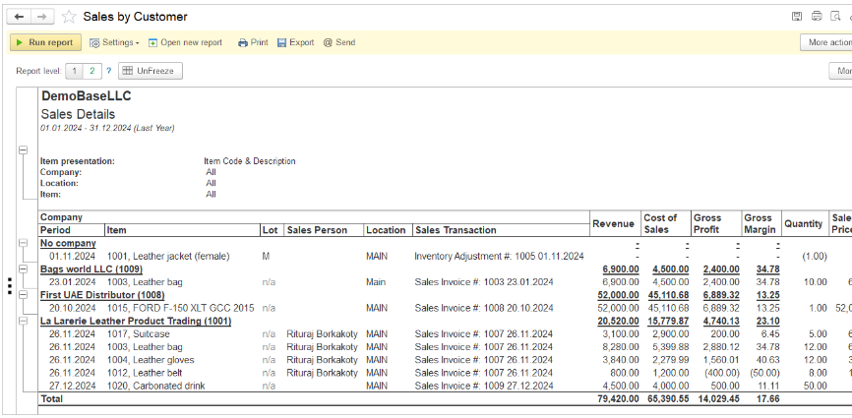
Sales Reports
+ various breakdown: with variants by Location, by Item, by Representative (Sales person), by Customer.
Structure menu to customize the report to hide/show additional measures Sales invoice, Sales order, Class, Project, etc.

Slide 28
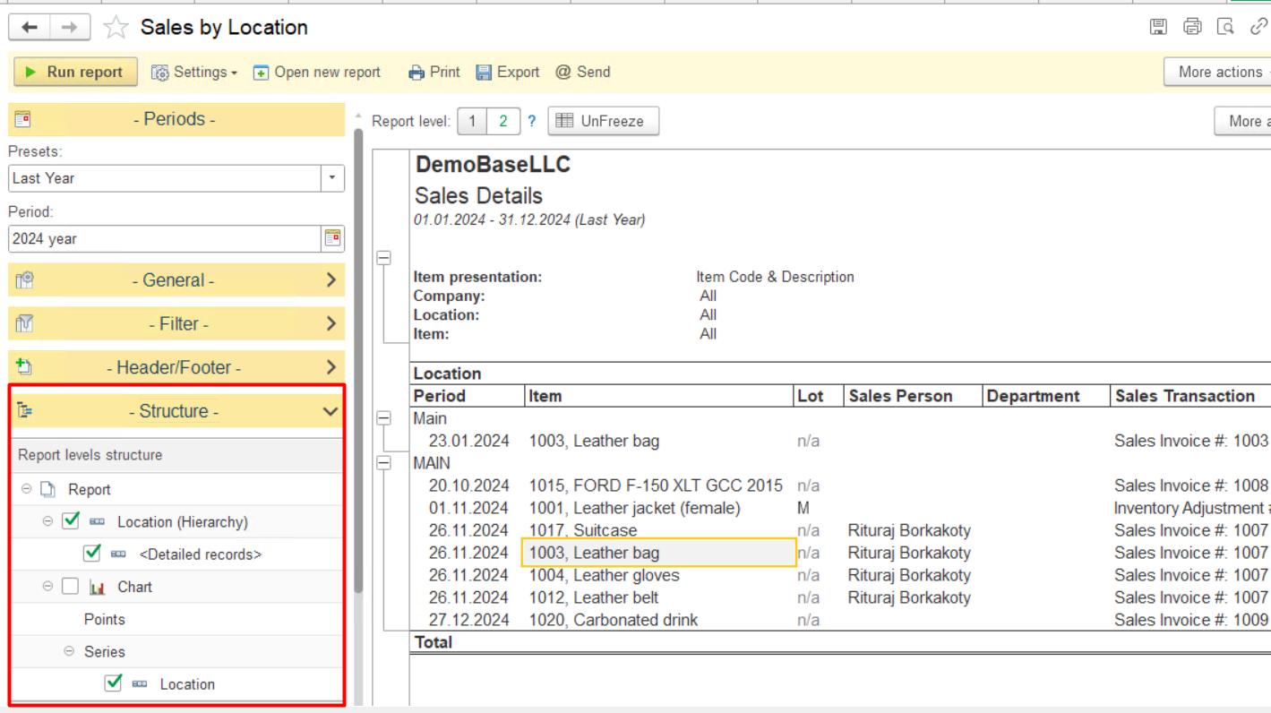
Flexible Reports
  Structure menu in the Settings panel, allowing users to easily customize report columns and report details from the report’s default options.

Slide 29
Flexible workflows
Purchases
Purchase requisition
Purchase order
Prepayment
Bill
Bill Payment
Purchase order
Items receipt
Bill
Bill Payment
Items receipt
Bill
Bill payment
Bill
Bill payment

Slide 30

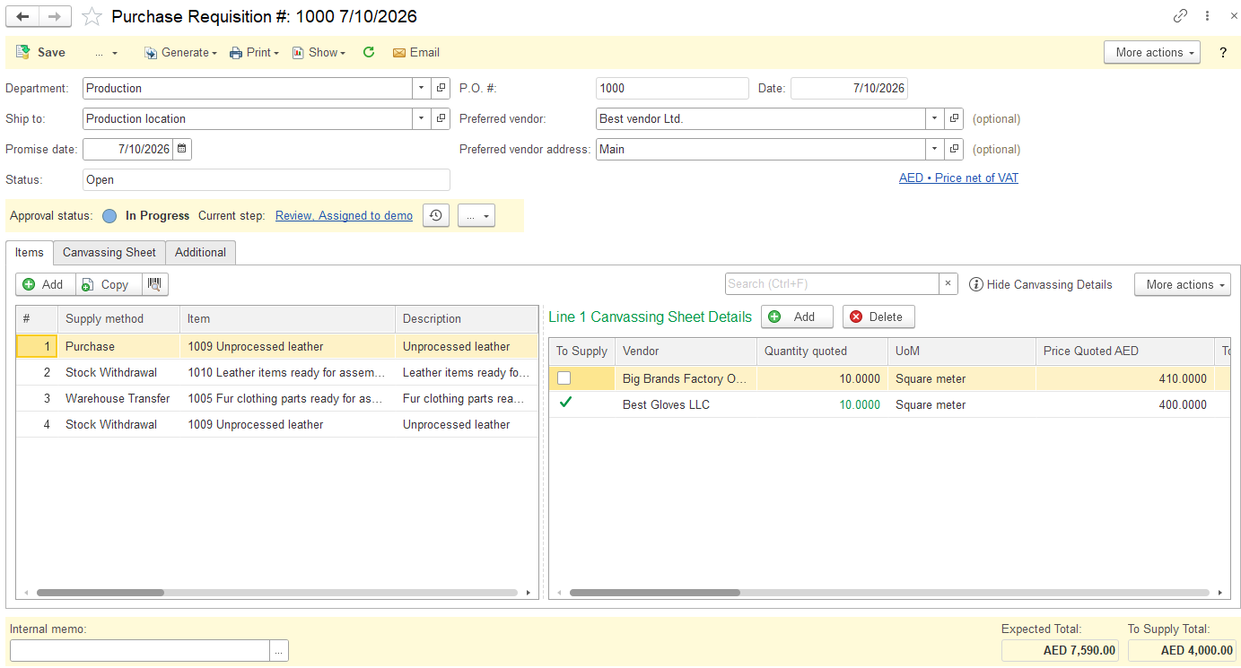
Purchase Requisition

Slide 31

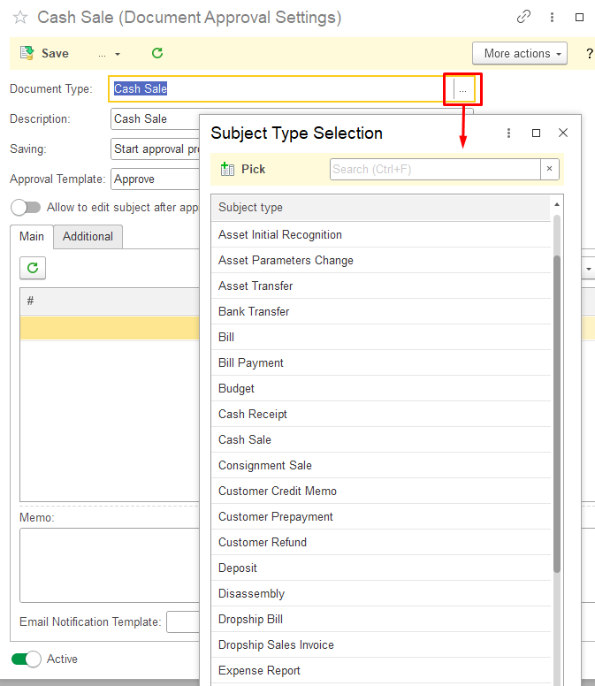
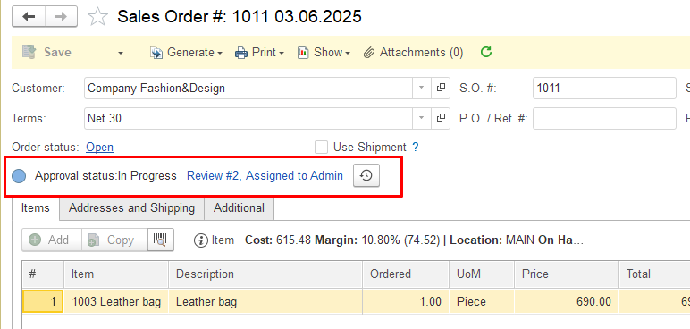
Approval Workflow – all docs available

Slide 32
Purchase orders
Purchases
Streamline ordering process
Clear documentation
Inventory Management
Audit trail
Notes:
1. Streamlined Ordering Process: Purchase orders provide a structured and standardized way to request goods or services, making the ordering process more efficient and reducing the chances of errors.
2. Clear Documentation: Purchase orders serve as a legal document that outlines the terms and conditions of the purchase, including pricing, quantities, delivery dates, and payment terms. This helps to avoid misunderstandings and disputes between buyers and suppliers.
3. Budget Control: By using purchase orders, organizations can track their spending more effectively and ensure that purchases are within budget. This helps to prevent overspending and improve financial management.
4. Inventory Management: Purchase orders help businesses keep track of their inventory levels by providing a record of items ordered and received. This can help prevent stockouts and ensure that the right products are available when needed.
5. Supplier Relationships: Using purchase orders can help strengthen relationships with suppliers by providing clear expectations and reducing the likelihood of misunderstandings. This can lead to better communication, improved reliability, and potential discounts or preferential treatment from suppliers.
6. Audit Trail: Purchase orders create a paper trail that can be useful for auditing purposes, allowing businesses to track their purchasing activities and ensure compliance with internal controls and regulatory requirements.

Slide 33
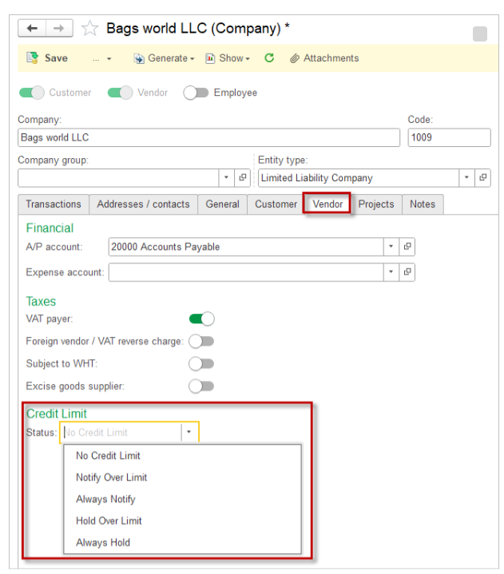
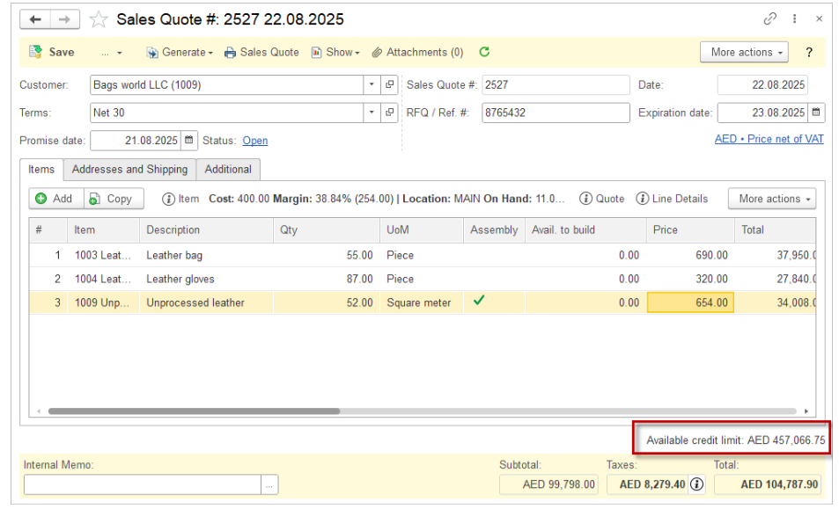
Credit Limit
Credit Limits for Customers and Vendors now available https://accountingsuite.io/docs/credit-limits/

Slide 34
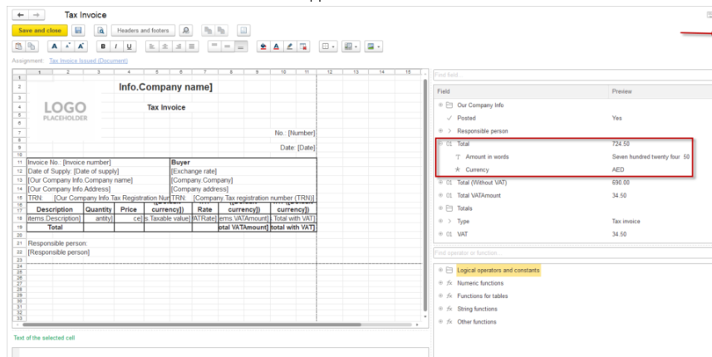

Print Forms
  Signature stamp can be added on a print form
  Users can now easily include a column sum in the print forms
  Product (Summary) attribute available on the Print from template
  Print forms templates for Bank Checks
Step by step guide:

Slide 35
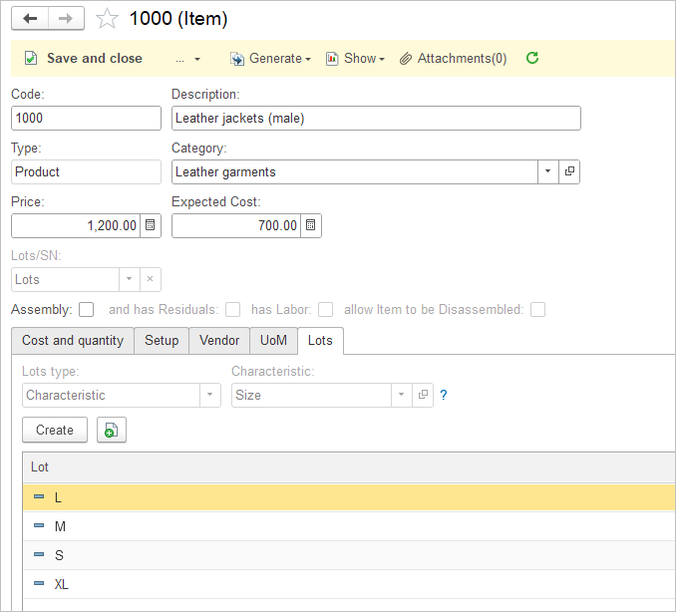
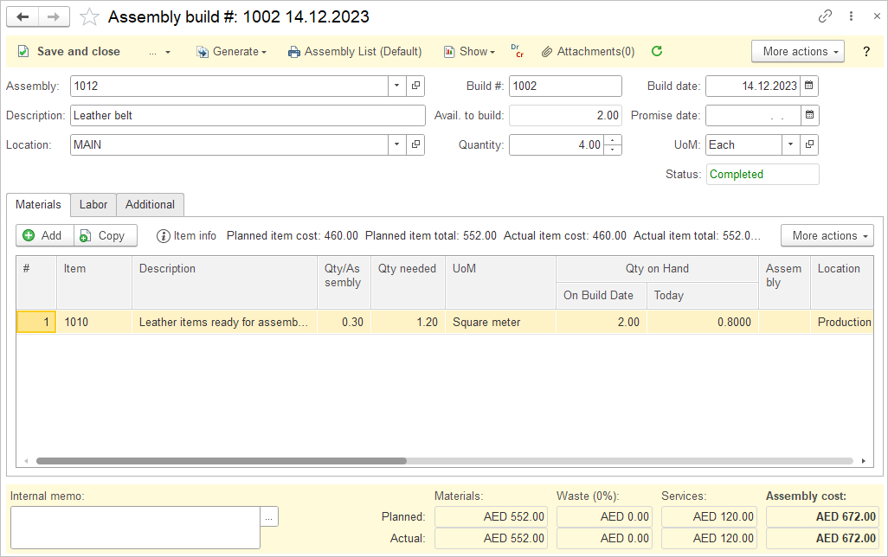

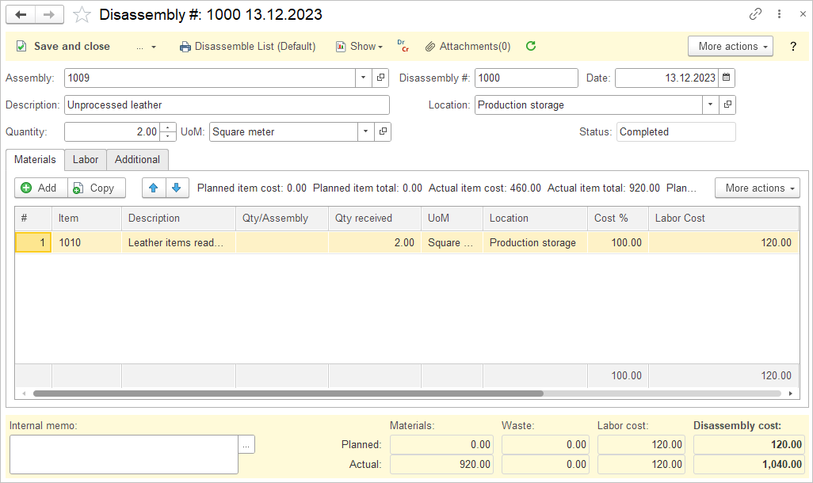
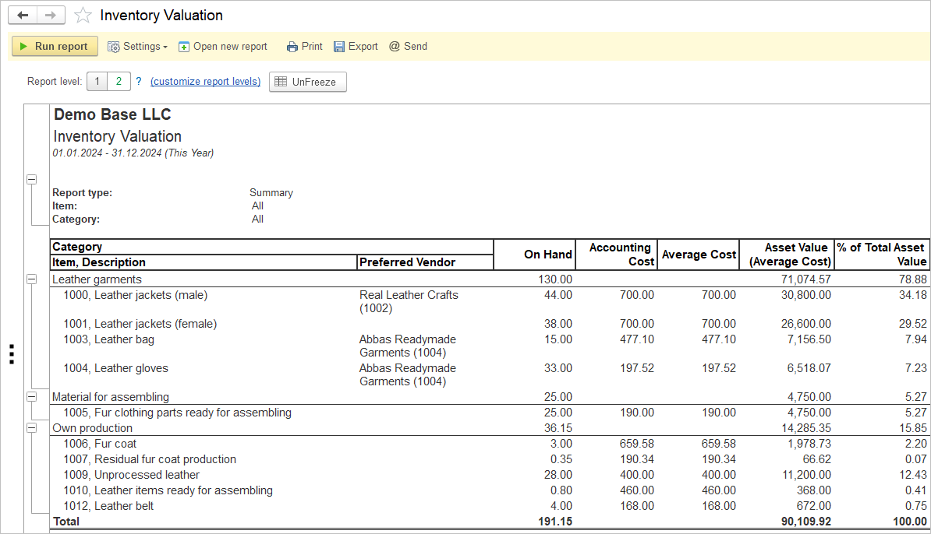
Inventory
Efficient management of stock levels
Detailed inventory, including:
Quality
Size / Color
Serial and Lot numbers
Units of measure
Multi-stage assembly and disassembly with labor and residuals
Landed cost allows to allocate any cost associated with freight, tax tariffs or anything else
Minimize stockouts and overstock

Slide 36
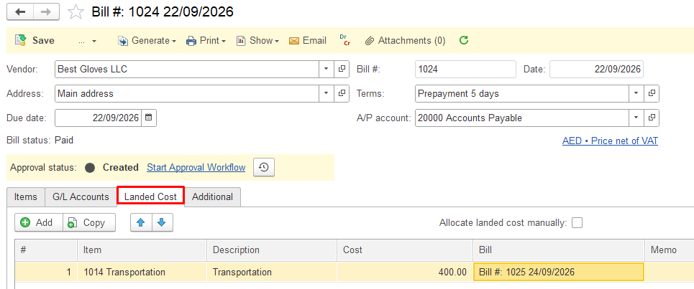
True cost of every product
Landed cost
May include shipping, customs duties, taxes, insurance, and handling fees
Makes product profitability easier to understand
Available in: Bill, Item Receipt, Warehouse Transfer Allocation base: quantity, amount or manually

Slide 37
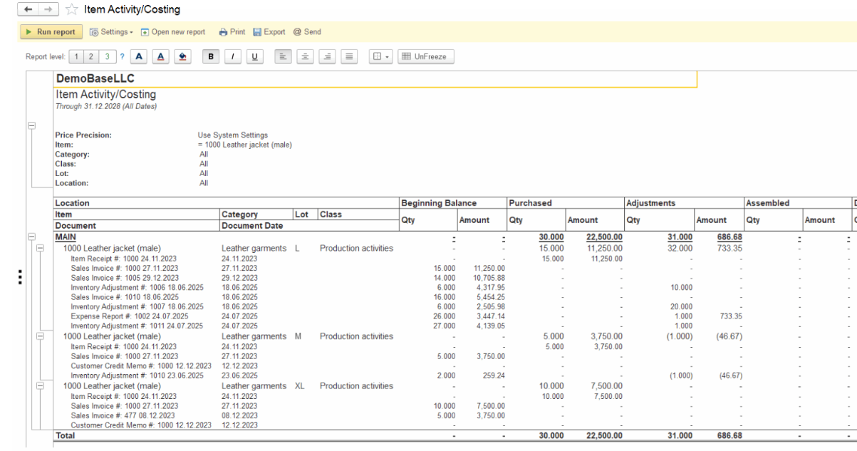
Advanced Reporting
Report has united both Item Costing and Inventory Unit Activity reports. The Structure of the report allows to check Sales Amount, Gross Profit, Gross Margin there

Slide 38

Projects & Time
Stay on track, stay on budget, stay successful
Customized breakdown of financial results
Enhance decision-making
Improved transparency
Track time for accurate invoicing
Control cost and prevent budget overruns
Resource
allocation

Slide 39
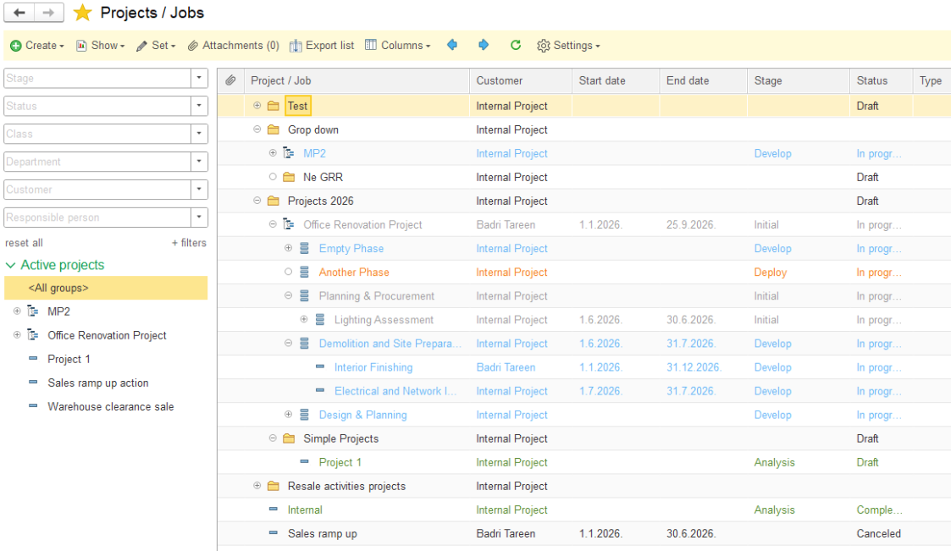
Complex Hierarchy in the Projects / Jobs list

Slide 40
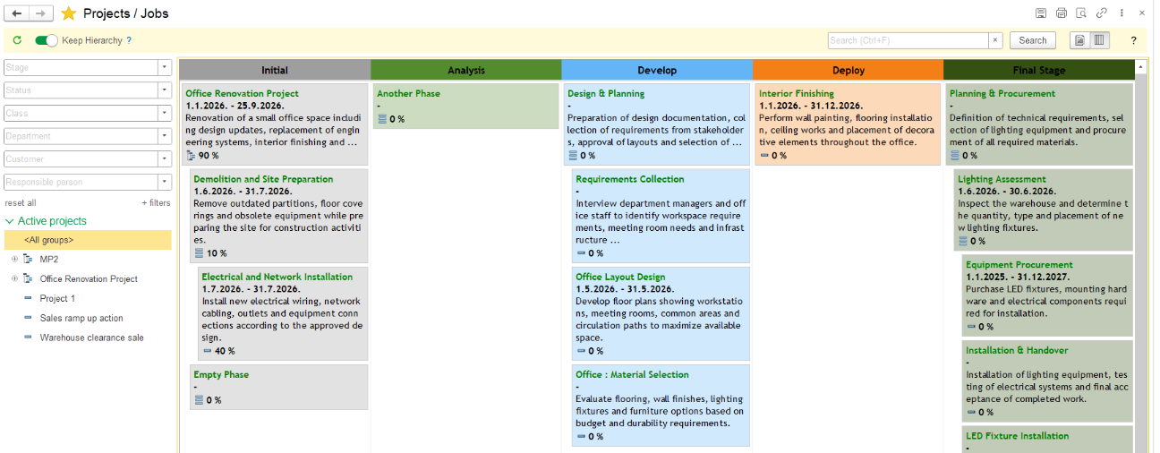
Kanban board for Projects

Slide 41
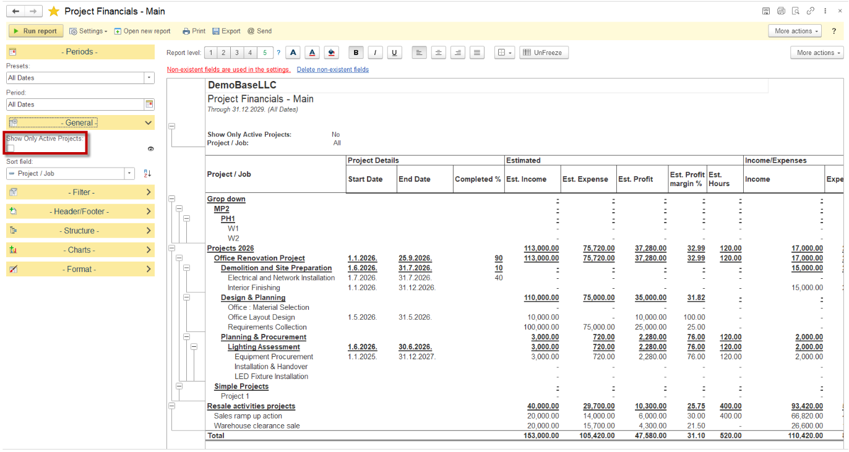
Project Financials

Slide 42

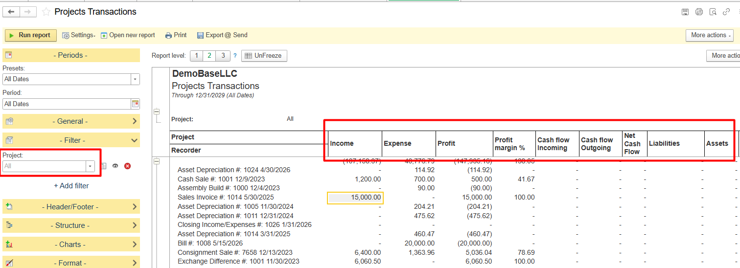
Project Transactions

Slide 43

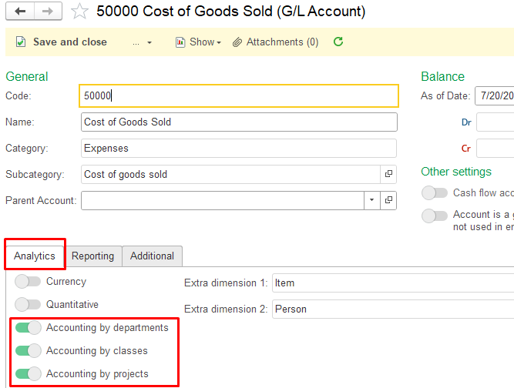
Enhancements in the Project Accounting

Slide 44
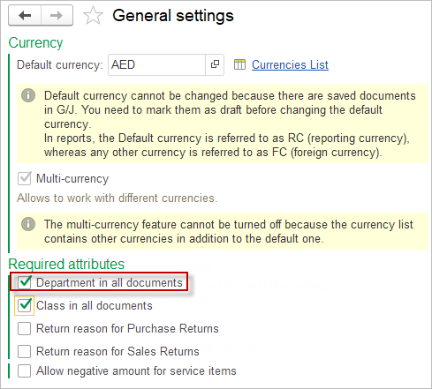

Department
Department = main cost center or business unit
Class = activity or segment inside that unit
Project = specific task, client job, or initiative

Slide 45
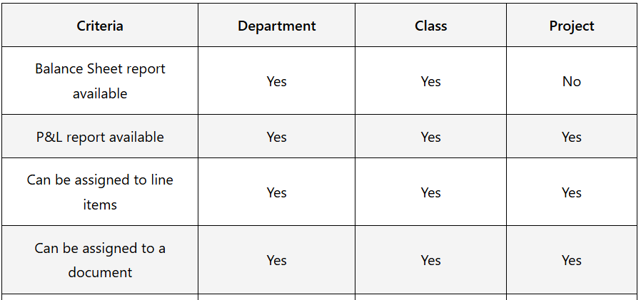
Department vs Class vs Project
Department = the main business unit, such as Production, Procurement, or Quality Control.
Class = a broader activity or product group inside that department, such as Machine Shop, Assembly, or Packaging.
Project = a specific order, production run, or improvement initiative.

Slide 46
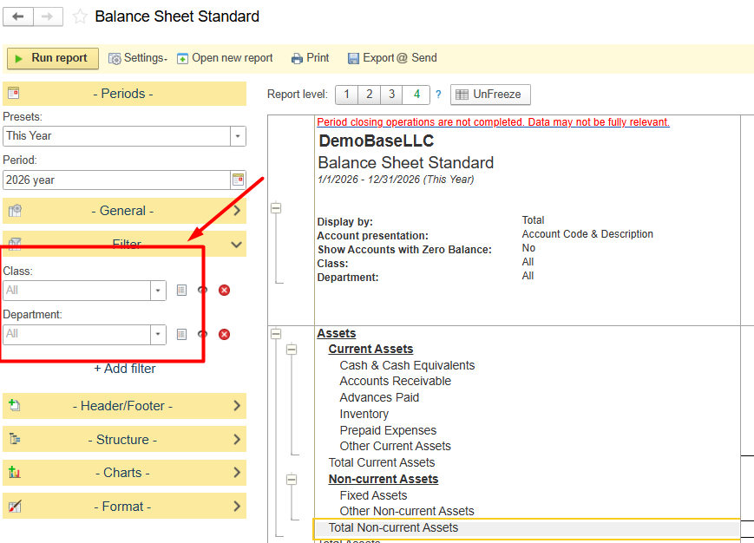
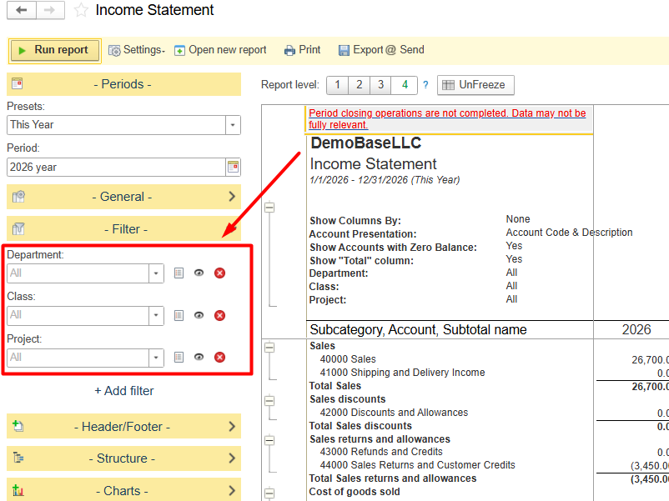
Department vs Class vs Project

Slide 47
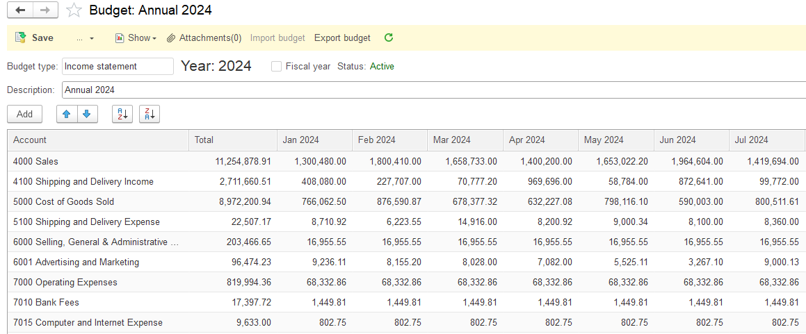
Budgeting
Confidence in the changing environment
Set financial goals
Track the expenses
Prioritize the spendings
Compare actual result to budget
Gain control over your finance

Slide 48

Bank
Control over your money
Multiple currencies
Cash in- and outflows
Automatic set-off of the liability
Import Bank Transactions (CSV/XLS)
Bank reconciliation
Cashflow report

Slide 49
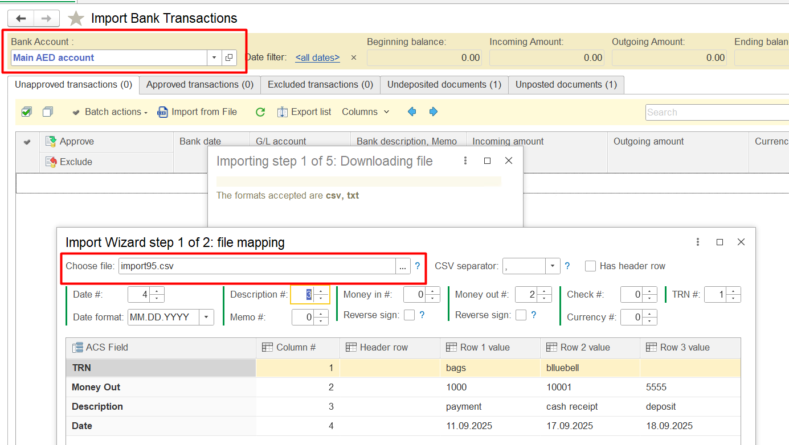
Import Bank Transactions (CSV/XLS)

Slide 50

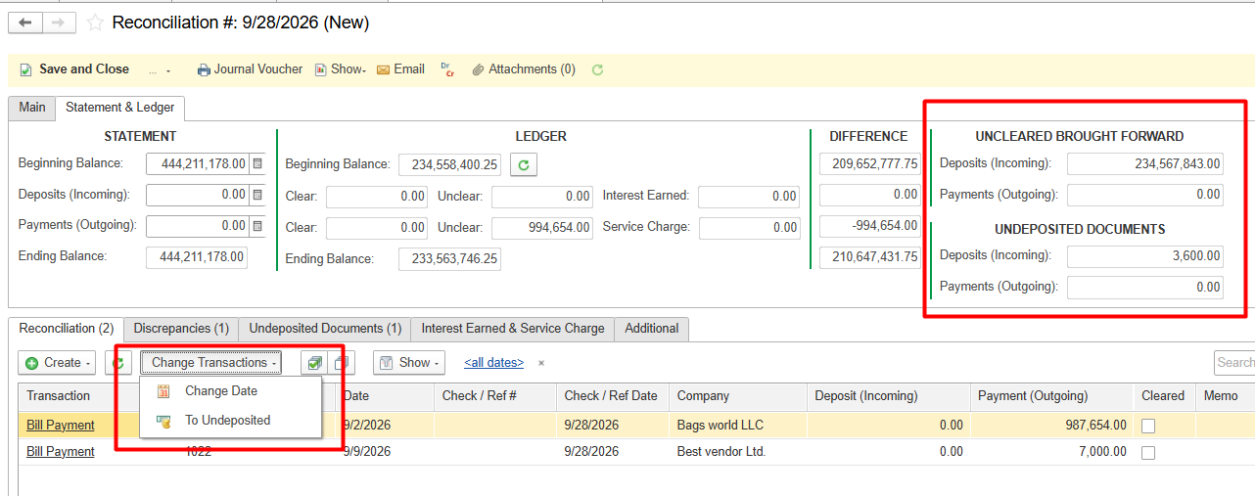
Bank Reconciliation works with Outstanding Checks

Slide 51
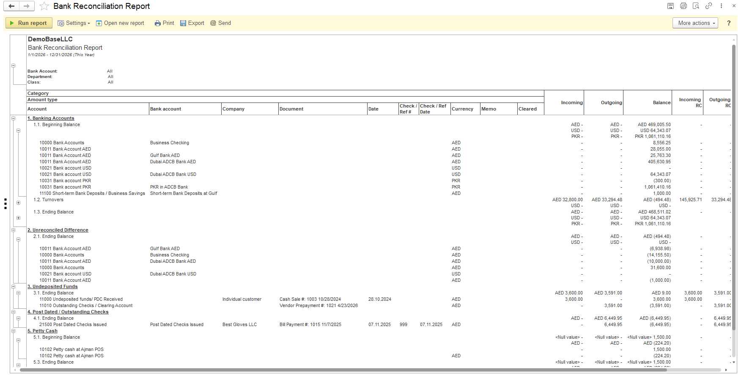
Bank Report

Slide 52
Taxes - overview
Common settings for taxes
Settings in the Tax:
Rate
Calculation base
Applicable date (From/to)
VAT
Excise
G/L accounts for each tax set in the Accounting settings
Withholding Tax
Levies
Dedicated G/L accounts for each tax rate

Slide 53
Taxes - overview
Specific settings for taxes
VAT
Default VAT rate
Prices to include VAT or be net of VAT
Withholding Tax
Upon invoicing / upon payment

Slide 54
Taxes - overview
Item tax parameters
Item
Tax group
Applicable taxes
Tax rate
Tax calculation base

Slide 55


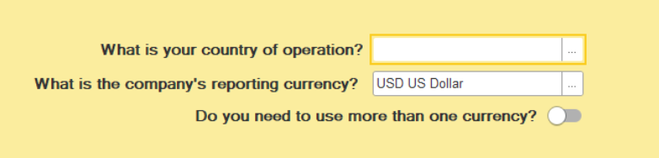
Country-Specific Preinstalled Data
Upon selecting the country in the Setup Wizard,
The system will be pre-installed with:
Local currency
Locally applicable taxes and their rates (e.g. VAT 5%, VAT 10% etc)
Tax authority in the Companies list
List of States
Local reporting forms should be connected separately!

Slide 56

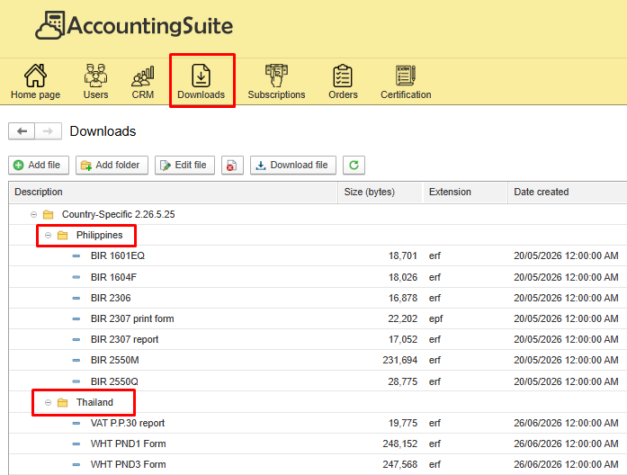
Statutory Reporting – Where to get the Forms
How to connect a reporting form:
for on-premises version – download form Partner’s Personal account and follow the guide
For Cloud version – please contact us and provide the database number where it should be applied.
For demonstration purposes, ACS demo base has all currently available reporting forms connected without any breakdown by country

Slide 57
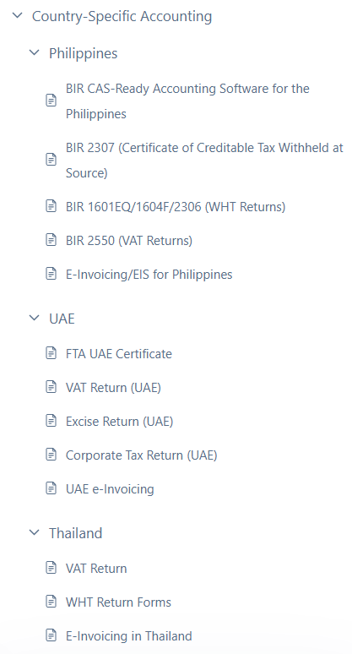
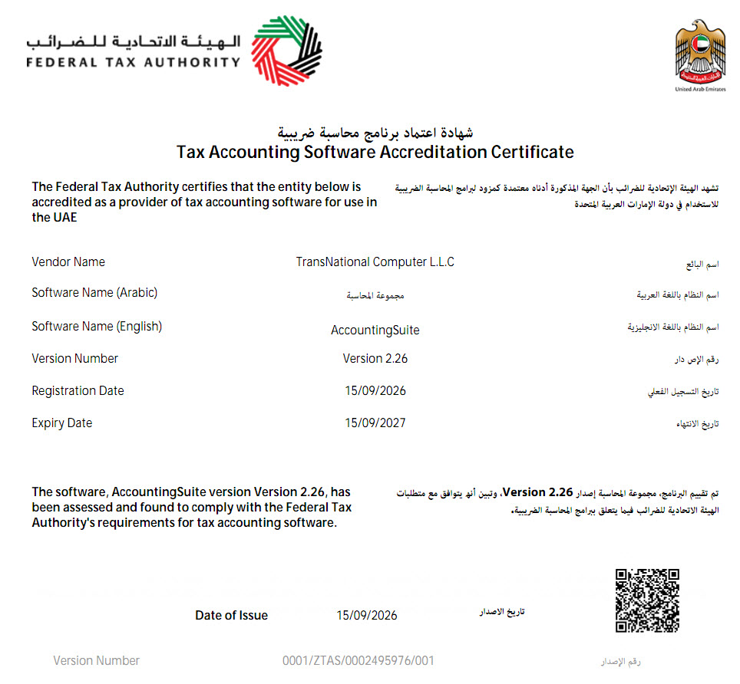
FTA UAE Certification
https://accountingsuite.io/docs/fta-uae-certificate/
We are pleased to inform you that our AccountingSuite has successfully passed the certification by the Federal Tax Authority UAE and Tax Compliance for accounting.

Slide 58
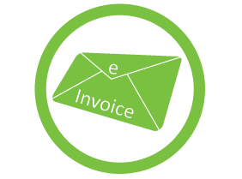
e-Invoicing ACS Service Schemes
ACS to be ASP itself
AccountingSuite
Cloud
ACS EDI Service
e-Invoice & Tax Reporting
Tax Authority
Service
AccountingSuite
On-Premises
PEPPOL
ASP

Slide 59


Asset management
Fixed assets, intangible assets, prepaid expenses, low value assets
Acquisition
Depreciation / Amortization
Revaluation / Improvements
Disposal

Slide 60

Payroll 1
Calculate and account for your employees’ salary and taxes
Flexible earnings and deduction
Personal Income Tax
Social insurance obligations
Adjusted business calendar
In-built overpayment check

Slide 61
Payroll 2
Calculate and account for your employees’ salary and taxes
Hourly based payment
Timesheets
Different types of absence tracking
Entire document import
Phase 3 upcoming

Slide 62
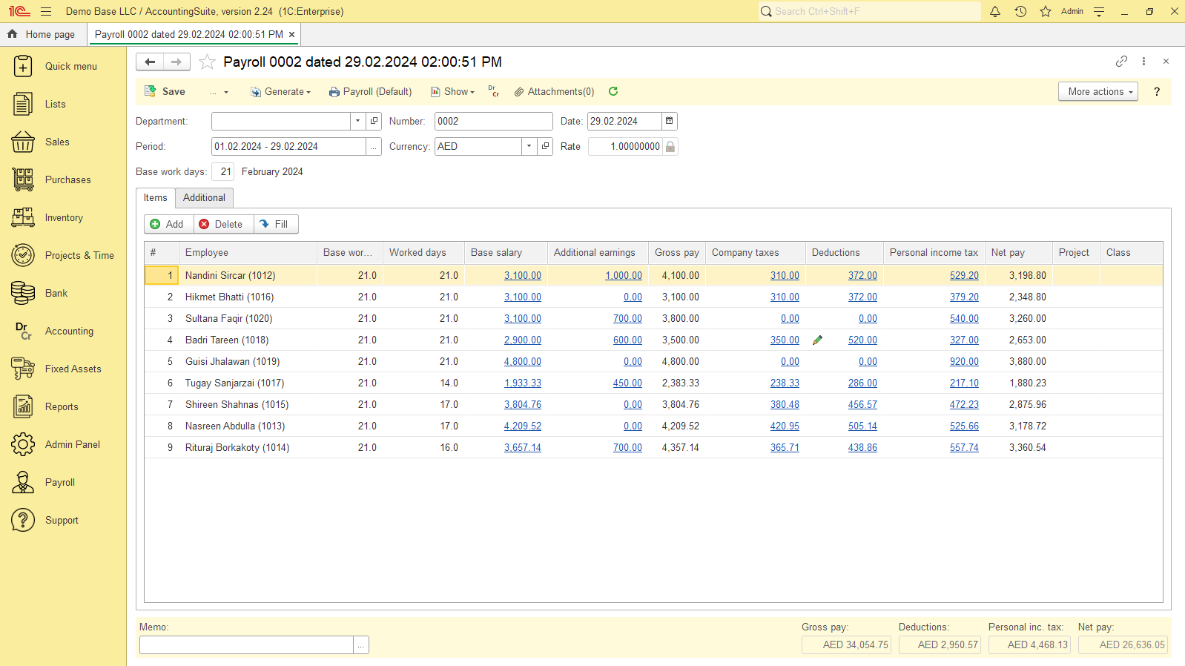

Slide 63

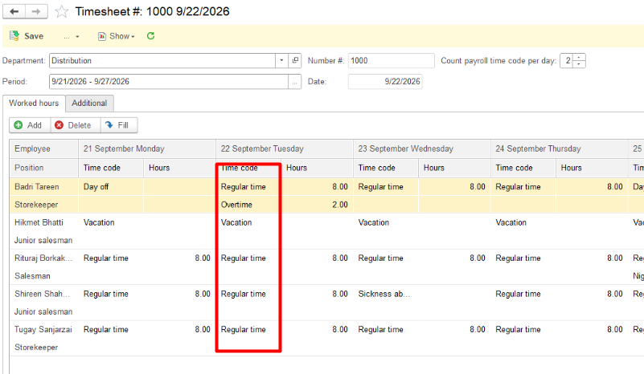
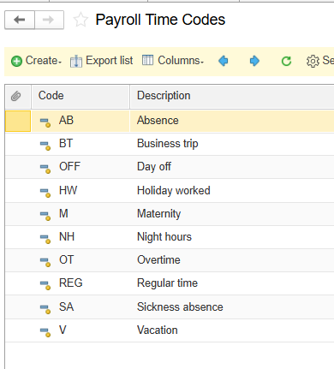
Payroll: Timesheet

Slide 64
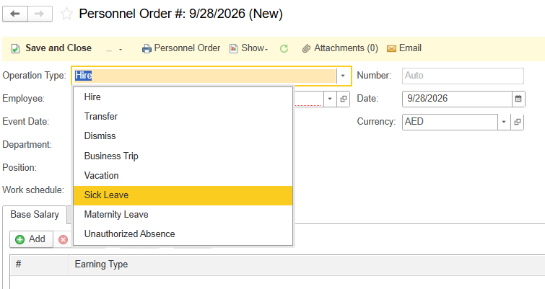

HR Backuping documents in the Personnel Order

Slide 65


Slide 66


Payroll: Labor Tracking

Slide 67
Print Forms
  Signature stamp can be added on a print form
  Users can now easily include a column sum in the print forms
  Product (Summary) attribute available on the Print from template
  Print forms templates for Bank Checks
Step by step guide:

Slide 68


Settings in the Period end closing wizard

Slide 69



Collaboration system
Video calls + Sharing screen
Use links in document’s chats

Slide 70

First steps with AccountingSuite
To start using our AccountingSuite, you need to register on our website AccountingSuite.io
Get a Trial Cloud version and start working immediately with your company data
The database can later be transferred to the On-premises version or the subscription can be extended for permanent use
On-premises users receive updates to their AccountingSuite version in their Portal Account and can check their subscription status
Try Demo link allows you to work with AccountingSuite demo base without registration to check the capabilities of the system and understand how well it covers your accounting needs

Slide 71




ON-PREMISE VS CLOUD
See more https://accountingsuite.io/features/on-premise-vs-cloud-version/
ON – PREMISE
Full control over data and infrastructure
Requires installation and maintenance of software on local servers
Suitable for organizations with strict data privacy and security requirements
Performs without Internet access
CLOUD
Hosted on remote servers, accessible via an Internet connection
Lower upfront costs as there is no need for hardware or software purchases
Enables remote access and collaboration from any location with stable Internet access
Are you ready for Cloud?
Please use Demobase and Trial Cloud for test Internet speed with AccountingSuite
Use Try Demo – Check Your Network Latency to check ping time (less 300 ms will be good)

Slide 72

Standard user
The user to work in the database. There are no advanced features or subscription management.

Slide 73

Partner user
Full control over subscription, users, databases

Slide 74

Downloads
1C Thin client and PDF User’s Guide – for Cloud
Server and files for On-premise

Slide 75

Backup and Restore
Backup management allows move to On-premise or to Cloud

Slide 76

Adding users
Add user for databases with user’s rights
Any user – you can be added to the client’s database or their to yours

Slide 77


The AI Assistant helps to read the documentation
The documentation is in PDF 1300+ pages. It is an AI knowledge base

Slide 78

AI answers difficult questions
You can check for AccountingSuite.io
A quick and clear answer to any question. An easy start to working with the system using artificial intelligence.

Slide 79

Built the AI directly into
On-Premise and Cloud AccountingSuite

Slide 80



AI works with AccountingSuite Data
https://accountingsuite.io/docs/ai-assistant/
Two AI models: Support or Accounting Assistant

Slide 81

AI Assistant works with Reports
Ask AI to do analysis with predefine prompt

Slide 82

AI Assistant do deep analysis and charts
Ask AI with your prompt in chat

Slide 83


Cloud or On-Premises AI Models
Why Local AI is Essential for Accounting
ASSISTANT
ANALYST
CONTROLLER
Complete Data Privacy: Financial data never leaves your company servers. Guaranteed compliance with strict regulations
Answers queries using knowledge base (1300+ pages). Semantic search across documents and master data. Explains complex financial metrics in plain language.
Predicts revenue, cash flow gaps, and tax liabilities. One-click "What If" scenario modeling. Automated tracking of expense dynamics.
Detects anomalies and suspicious journal entries. Automated accounting policy checks. Monitors limit breaches and duplicate records.
OpenAI compatible API: Deploy open-source LLMs locally on your own hardware without internet access.
Zero Token Fees: Process millions of ledger entries and document scans with no per-request API costs or recurring tokens
Ideal for On-Premise deployments and highly regulated enterprise sectors.

Slide 84

Release Notes
https://accountingsuite.io/release-notes/
It will be opened after updates inside the system

Slide 85



Where to find ACS Roadmap plans

Slide 86


Support forum
Works via Smartphones

Slide 87

Subscribe news forum topic
https://accountingsuite.io/forum/
To keep up to date with all the news via email
Subscribing to RSS feeds

Slide 88

Support
Support tab inside the system

Slide 89

Implementation Steps
https://accountingsuite.io/docs/implementation-steps/
Phase 0 — Fit-Gap Analysis: questionnaire, demo database check, compliance check, document gaps, fit-gap table.
Phase 1 — Pre-Implementation Planning: define objectives & requirements, data audit & cleanup, choose deployment model (Cloud / On-Premises).
Phase 2 — System Setup & Data Migration: configure AccountingSuite, test migration (pilot run), full data migration via import tools.
Phase 3 — Training & Go-Live: user training, parallel run, go-live & post-launch support.
Key Success Factors: executive buy-in, data accuracy, change management.

Slide 90
Useful Tips for Partners — How to Start Implementation
https://accountingsuite.io/docs/implementation-steps/
Prototyping & Deployment
How to create a prototype database for the client?
How to restore a database backup to a new subscription?
How to replicate a configured database for multiple companies?
How to demonstrate the correct subscription edition to a client?
Customization & Development
How to develop a customization for a client with a cloud database?
How to preserve customized reports during system updates?
Project Planning & Data
How to plan the project timeline realistically?
How to effectively use data import tools?
How to work with the client’s “legacy” data?
Training & Support
How to conduct effective user training?
How to structure post-launch support?
Growth & Risk Management
How to upsell additional functionality after successful implementation?
How to run a pilot project to reduce risk?
How to build a transparent commercial offer?
How to leverage the AccountingSuite Partner Network?

Slide 91

How to create a prototype database for the client?
Situation: You need to start the implementation quickly without complex client-side preparation.
Solution: If your client has purchased the On-premises version, begin by using the Cloud version of AccountingSuite to build a prototype.
Why it works: In the cloud, you can instantly create a database and invite both your consultants and the client’s users via email. There’s no need for immediate involvement from the client’s IT administrator to access their internal network. and on-premises installation
Key Benefits:
  Fast Start: You can begin configuration and demonstrate results on day one.
  Gain Time: This approach gives you additional time to study the specifics of on-premises administration at the client’s site.
  Seamless Transfer: Once the prototype is ready, you simply create a backup in the cloud and restore it on the client’s on-premises server. The Cloud and On-premises versions are fully compatible.
On-premise and Cloud are fully compatible!

Slide 92
How to replicate the database with settings for other companies?
Situation: You need to perform mass implementations (e.g., for different countries or for multiple branches within a corporation).
Solution: Create and reuse a standardized “template” database.
Process:
  Set up a master database with all the necessary default settings for a specific region or company type. This typically includes:
    Country-specific Chart of Accounts
    General Ledger Settings
    Address Classifiers
    Tax Rates and Tax Agent configurations
    Payroll Settings
    Print Form Templates
    Localized Reporting Variants
  Save this fully configured database as a backup file.
  For each new client or branch in that region, deploy a fresh instance from this template backup.
  Finally, import the client’s specific operational data (like items, contractors, balances) using the standard Data Import Tool.

Slide 93

UI Localization
https://accountingsuite.io/demobase/
Select the user account for your language:
— demo (English)
— demo_ar (Arabic)
— demo_fr (French)
— demo_pt (Portuguese)
— demo_th (Thai)
New languages in work:
— Khmer
— Chinese
— Mongolian

Slide 94

Thai UI

Slide 95

Arabic UI

Slide 96

French UI

Slide 97


Small and Medium On-Premises AccountingSuite Deployments
https://accountingsuite.io/docs/system-requirements/

Slide 98




What’s next?
Visit our website
Try out our free
demo base
Download the
mobile application
Read the user guide

Slide 99


Telegram Channel
Our official channel for AccountingSuite.io, 1C:Enterprise, 1C Trainings and competitions, News and updates.
https://t.me/accountingsuite

Slide 100


1С SkillCamp Onboarding into AccountingSuite course
https://1c-dn.com/learning/onboarding_into_accountingsuite/

Slide 101


1C:Enterprise First Step. Beginners Course
https://1c-dn.com/learning/1c_enterprise_first_step_beginners_course/

Slide 102
You can do accounting easier with AccountingSuite

