Slide 1

AccountingSuite Overview

Slide 2
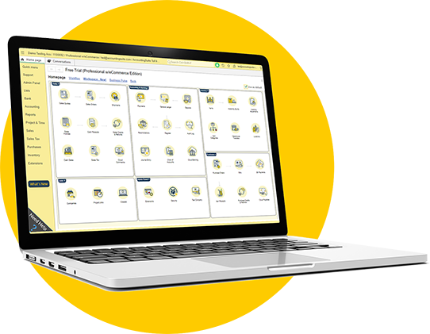
What AccountingSuite is
Software for small and medium-sized businesses which covers all activities and functions for any types of business
Outstanding benefits for companies to have a sustainable development as well as optimizing competitive advantages
Management reports are flexible and can be easily edited and customized by users to suit their purposes

Slide 3
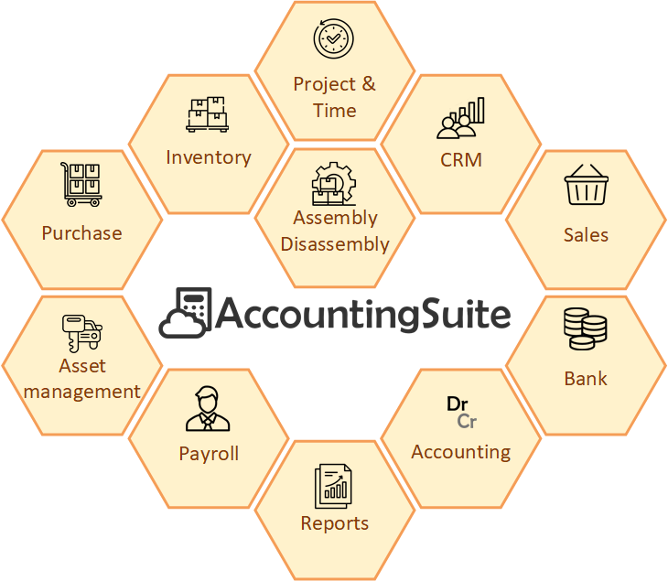
Software module scheme

Slide 4

Which companies use AccountingSuite?
Trading activities – 62%

Slide 5
Who is the target audience of AccountingSuite?
Accounting Practices & Freelance Accountants (CPA)
Small & Medium Enterprises (SMEs) – Core Users
Characteristic | Description
Profile | Independent accountants, small accounting firms, freelance CPAs managing books for multiple clients.
Business Size | 1-5 employees (the practice itself). Serves multiple SMB clients (1-50 employees each).
Industry Focus | Various (Trade, Services, Simple Manufacturing across their client portfolio).
Primary Needs | 1. Manage multiple clients’ books in one/system. 2. Easy onboarding for new clients. 3. Core accounting, invoicing, reporting. 4. Compliance with local tax regulations. 5. Affordable, predictable cost (per client or user). 6. Reliable data access (cloud crucial).
Preferred Edition | Standard (multi-entity/client support). Lite for starters or solo practitioners with few clients.
Key Decision Drivers | Cost-effectiveness per client, ease of use, reliability, local compliance features, cloud accessibility.
Characteristic | Description
Profile | Owner-managed businesses, growing companies with dedicated finance staff (1-3 accountants).
Business Size | 5-80 employees, up to ~50 concurrent software users.
Industry Focus | Wholesale & Retail Trade, Import/Export, Services (IT, Consulting, Hospitality), Simple Manufacturing/Assembly, Agriculture (post-harvest, trading).
Primary Needs | 1. Integrated financial management (GL, AP, AR, Inventory, Payroll, Assets). 2. Basic inventory & sales management for trade. 3. Simple production costing. 4. Multi-user access with role permissions. 5. Basic reporting & dashboards for decision-making. 6. Local tax and financial reporting compliance.
Preferred Edition | Standard (for service companies), Premium for those needing advanced modules (e.g., Advanced Inventory, CRM, Assets).
Key Decision Drivers | Functionality fit, total cost of ownership, scalability, ease of implementation, local support availability, data security.

Slide 6
Who is the target audience of AccountingSuite?
Growing & Larger Companies (Requiring Customization)
Characteristic | Description
Profile | Established medium-sized companies, subsidiaries of larger groups, companies with complex processes.
Business Size | 60-500+ employees, up to 300-500 concurrent software users.
Industry Focus | Distribution, Light Manufacturing, Services with multiple branches/locations.
Primary Needs | 1. Scalable system to support growth. 2. Customization to fit unique business processes. 3. Integration with other systems (CRM, e-Commerce). 4. Advanced reporting, budgeting and analytics. 5. Multi-company/consolidation support. 6. High performance with many users.
Preferred Edition | Premium + Custom Development (leveraging open 1C platform), On-Premises.
Key Decision Drivers | Flexibility/customization potential, long-term scalability, total cost vs. building a custom system, the possibility of in-house development in 1C open source code.

Slide 7

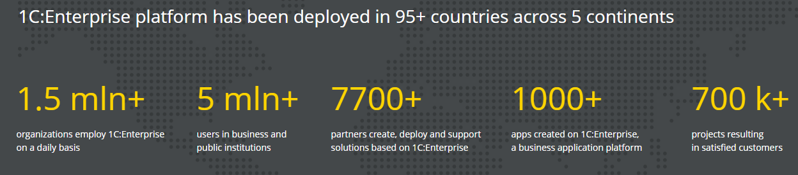
Worldwide experience
AccountingSuite was developed using the powerful 1C:Enterprise Platform
1C:Enterprise is leader in Russia and across the world with over 30 years experience in Accounting and ERP software

Slide 8


Partner
AccountingSuite
Extensions
Third-party integration
Partner’s
Applications
Vendor
AccountingSuite
Application
Other
1C Applications
1C Platform
File Mode
Database
Database Management System
(PostgreSQL, MS SQL)

Slide 9
Software features
One software for everything your company needs
Cash
Purchases
Inventory
Sales
Cash
Payroll
Accounting
Fixed assets
Financial
Tax
Management

Slide 10
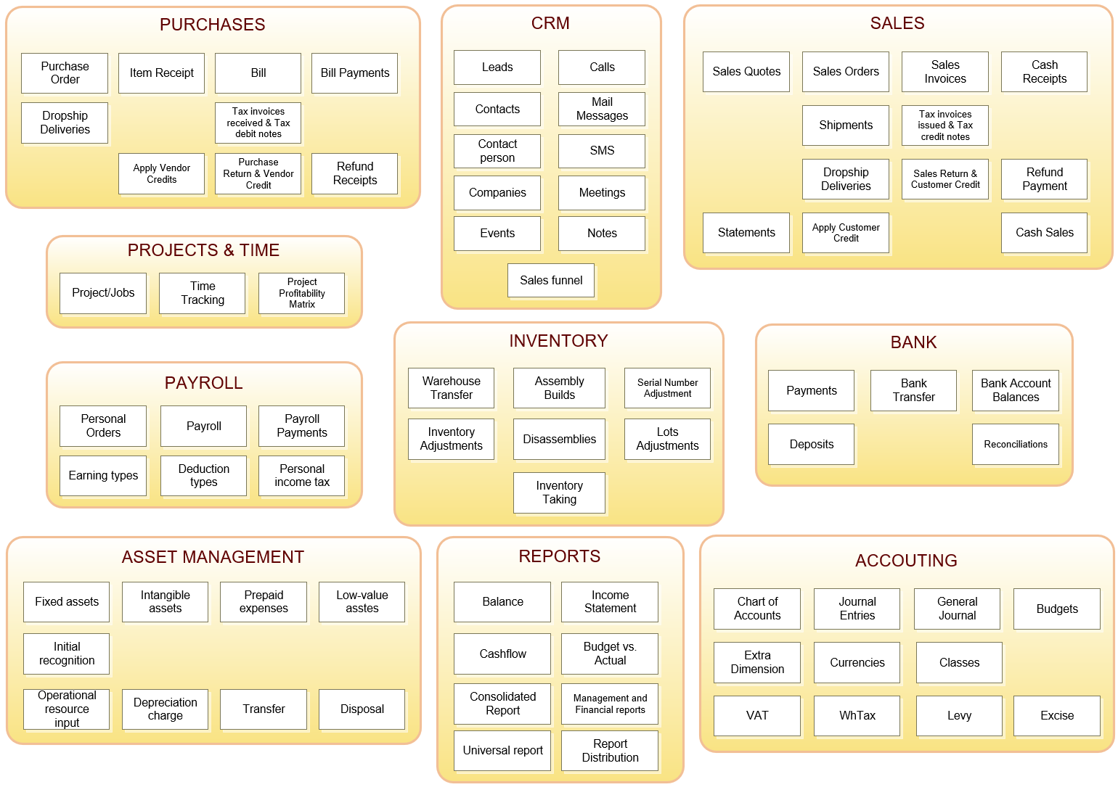

Slide 11
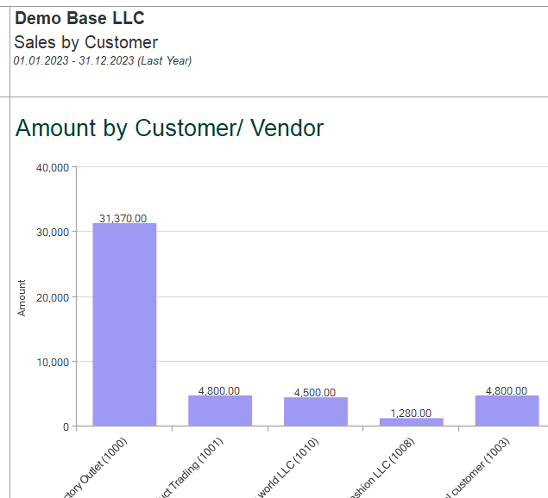
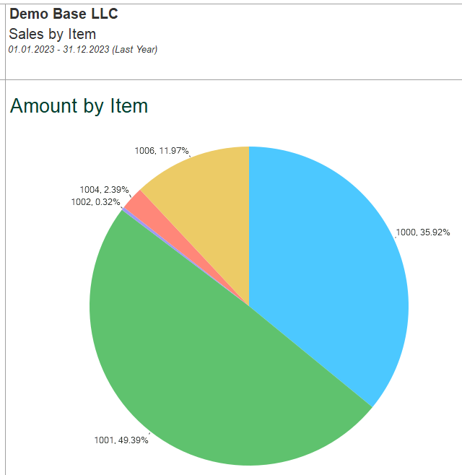
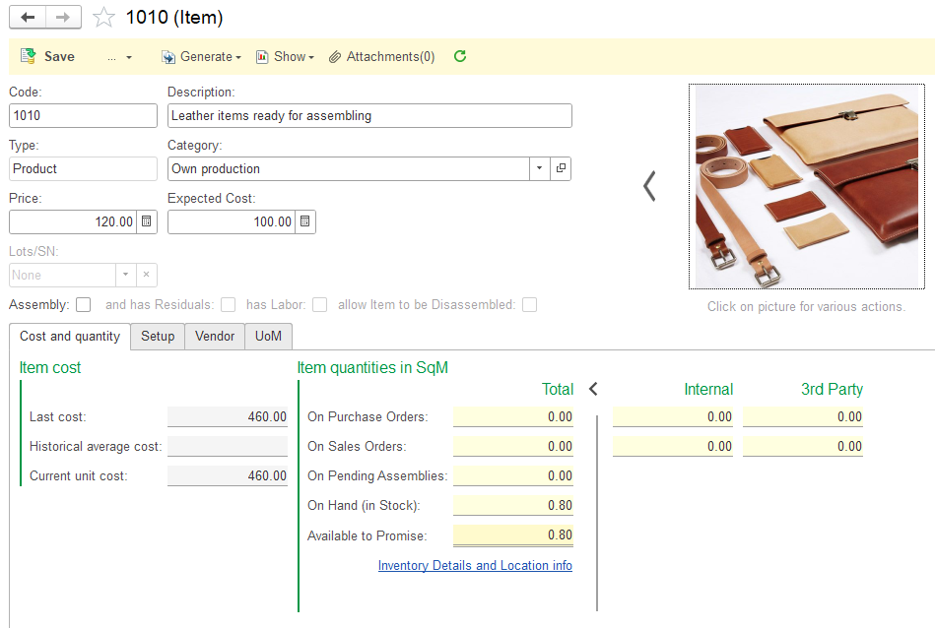
All-in-one solution to manage small or medium-sized business
AccountingSuite – what for?

Slide 12

Extensions
DEFAULT
CUSTOMIZED
Provided quickly for bug-fixes, so you do not have to wait for the new release
Customized extensions can be ordered from your provider and are designed specifically for your company’s needs
No need to modify the standard configuration

Slide 13


Features: On-premise or Cloud
ON-PREMISE
CLOUD
Full control over data and infrastructure
Requires installation and maintenance of software on local servers
Suitable for organizations with strict data privacy and security requirements Performs without Internet access
Hosted on remote servers, accessible via an Internet connection
Lower upfront costs as there is no need for hardware or software purchases
Enables remote access and collaboration from any location with stable Internet access

Slide 14


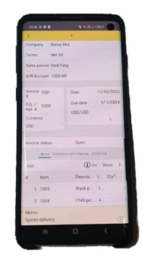

Features: Mobile application
ACCESS FINANCIAL DATA ANYTIME, ANYWHERE
Increased productivity
Responsiveness to urgent financial matters

Slide 15

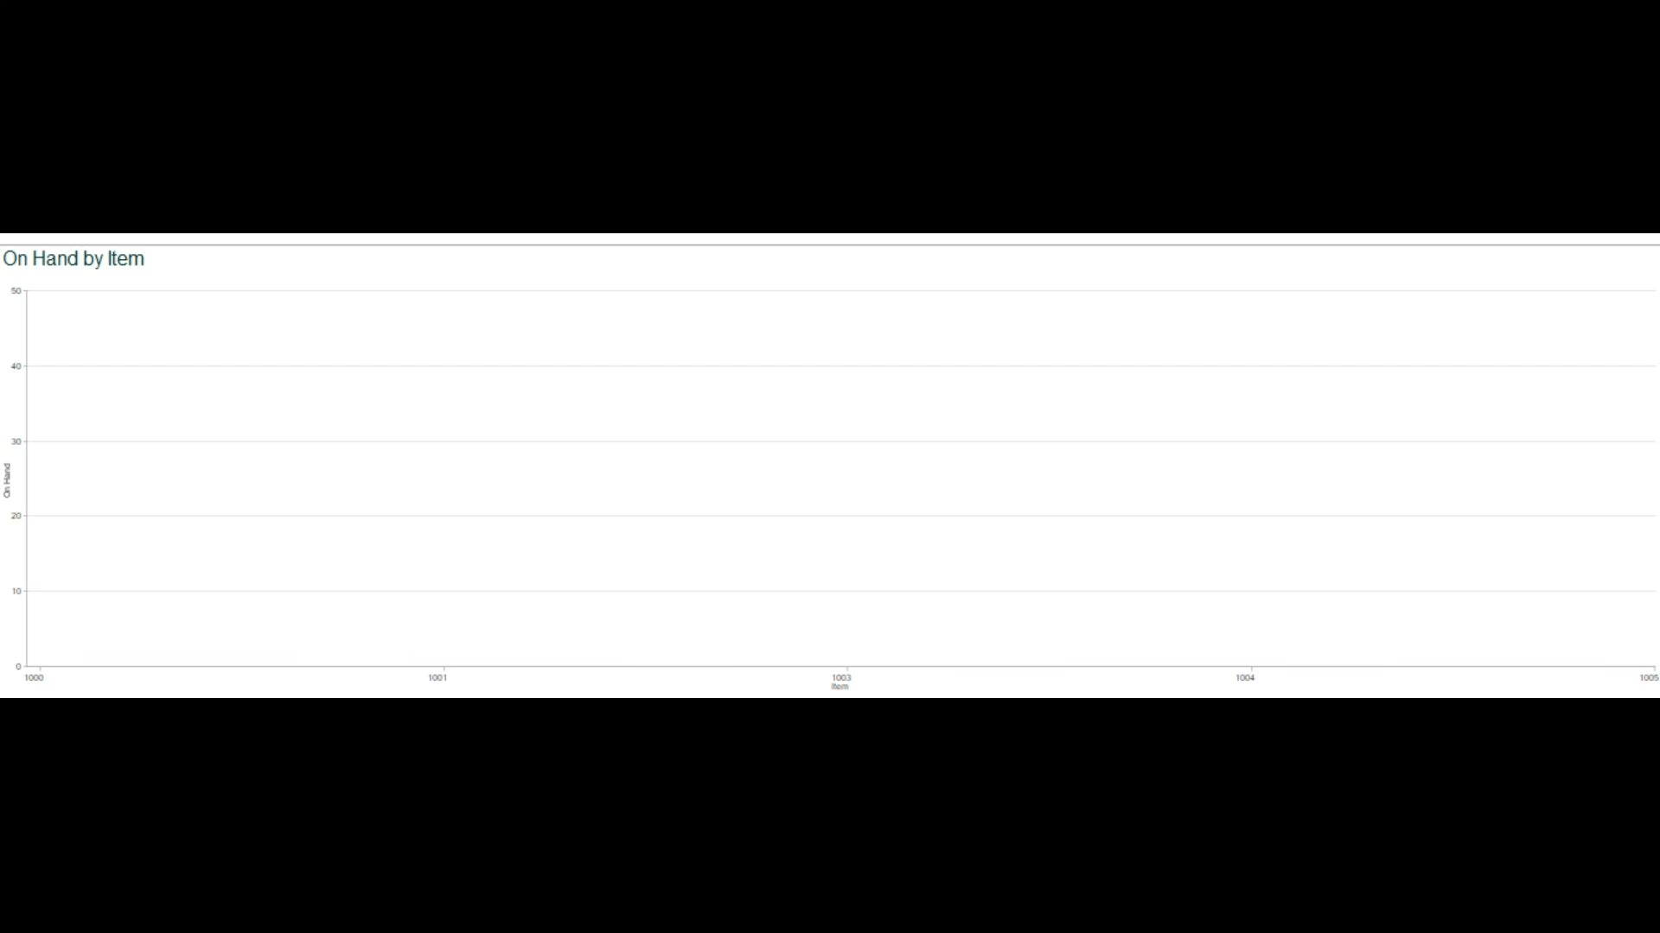
Features: Real-time reports
Access the most up-to-date information and make informed decisions quickly, without having to wait for manual updates or reports
Allows for increased productivity and responsiveness to urgent financial matters

Slide 16
Features: Data Import Tool
Streamlines the process of migrating data from the previous system to AccountingSuite
Reduces manual data entry errors and saves time
Migrate historical data or closing balances using CSV/XLS
Allows to customize and map data fields between systems
Preserves data integrity and accuracy during migration

Slide 17

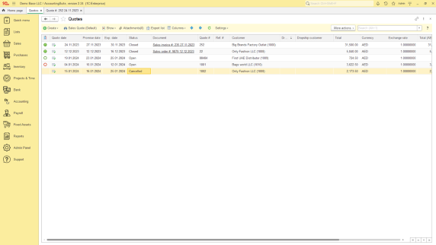

Features: Video tutorials
User guide

Slide 18
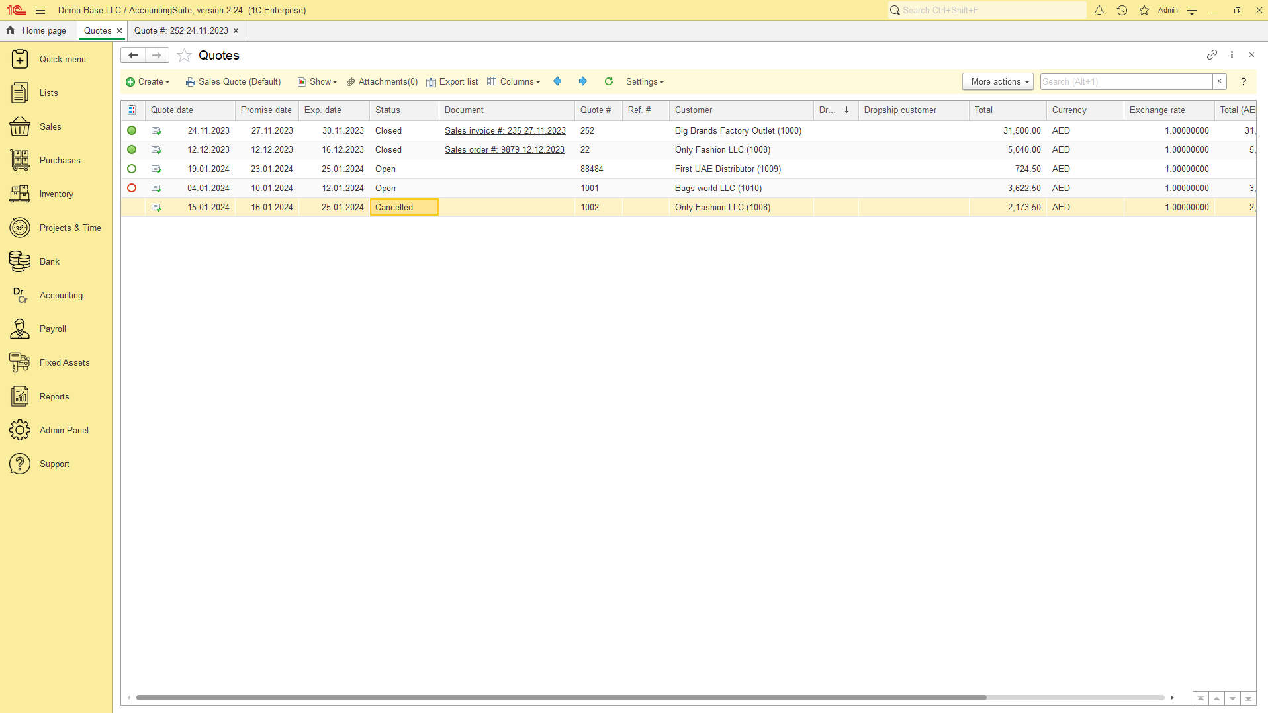

Slide 19


Slide 20
FEATURES OVERVIEW

Slide 21
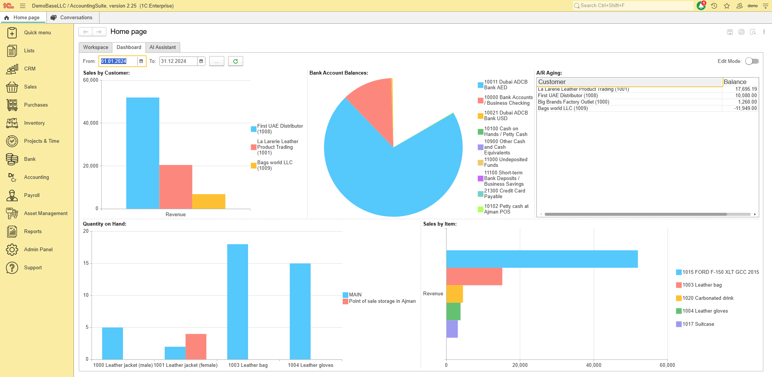
Dashboards

Slide 22
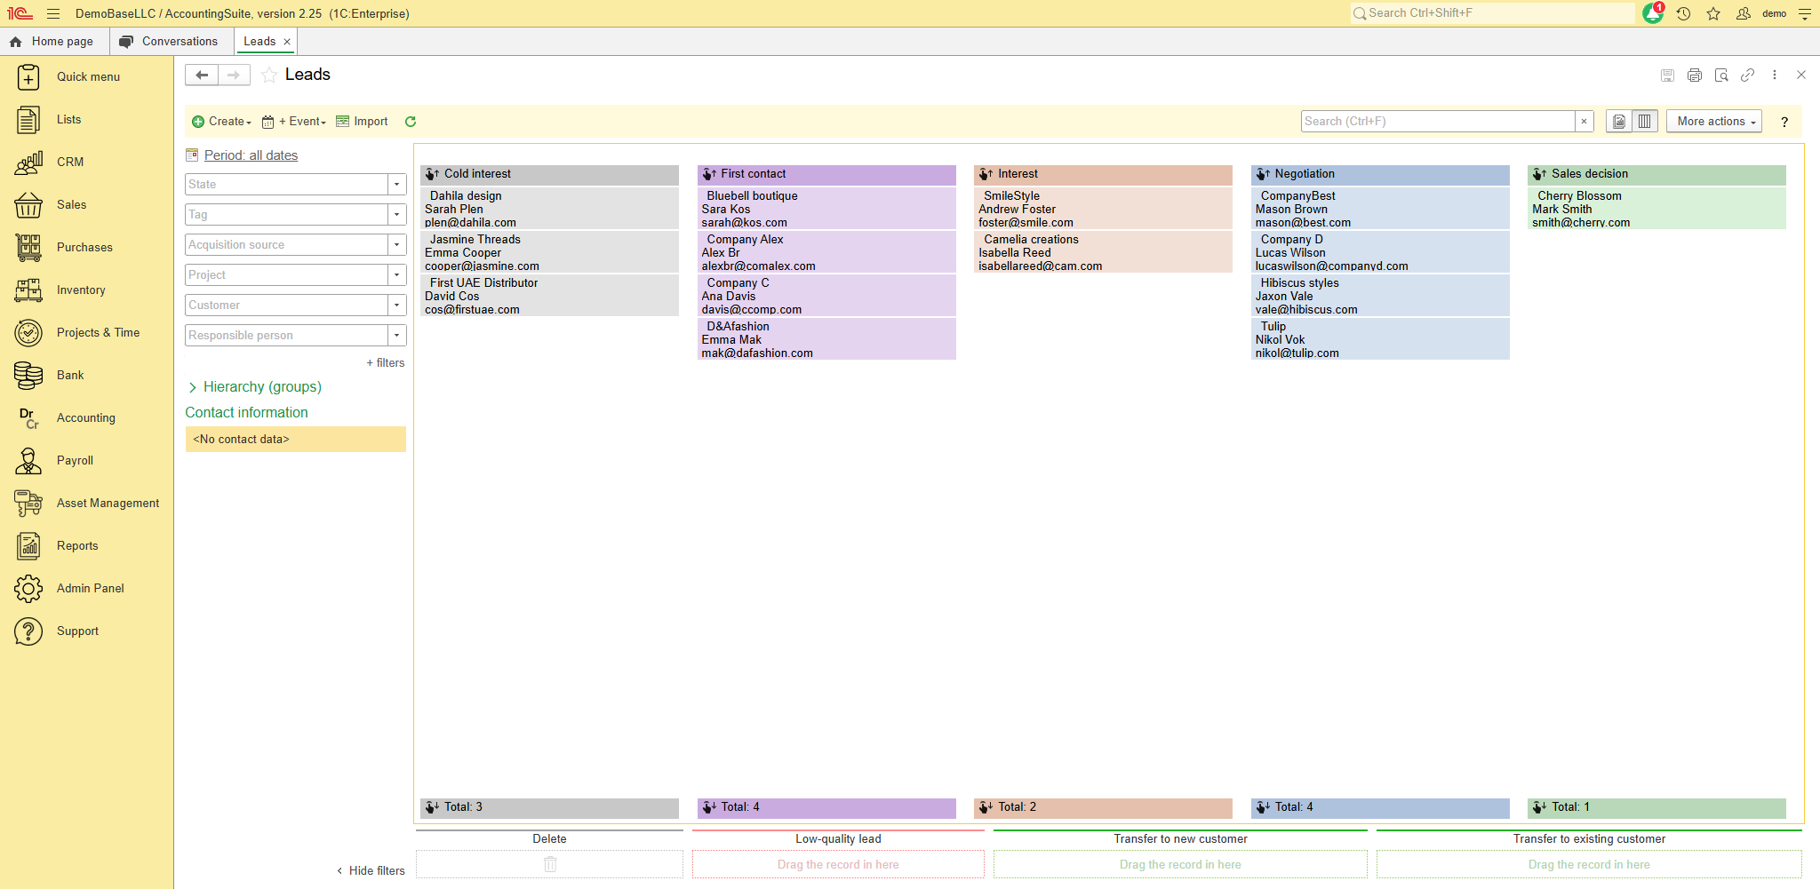
Customer Relationship Management

Slide 23

Wholesale
Sales
E-commerce
Retail
Consignment
Sales orders – Discounts – Shipping - Dropshipping

Slide 24

Flexible workflows
Sales
Sales Quote
Sales Order
Prepayment
Sales Invoice
Cash Receipt
Sales Order
Sales Invoice
Cash Receipt
Sales Invoice
Cash Receipt
Cash Sale

Slide 25

Ship seamless, sell effortless
Sales - Dropshipping
No obsolete inventory
DROPSHIPPER
DELIVERY
No need to worry about delivery
ORDER
CUSTOMER
Wide product range
YOUR COMPANY
ORDER
PAYMENT
Flexible location

Slide 26

Consignment shops handle the selling process for you, saving you time and effort
Consignment sales
Lower storage cost
Access a wider market of potential customers
Benefit from the expertise and marketing strategies of the consignment shop
This option gives your items a second life, reducing waste and promoting sustainability

Slide 27
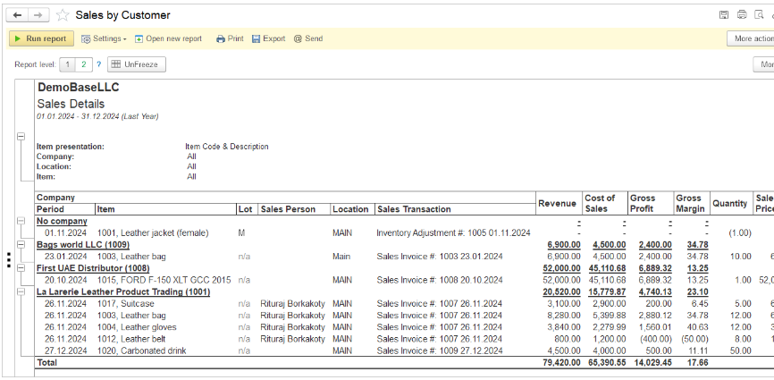
Sales Reports
+ various breakdown: with variants by Location, by Item, by Representative (Sales person), by Customer.
Structure menu to customize the report to hide/show additional measures Sales invoice, Sales order, Class, Project, etc.

Slide 28
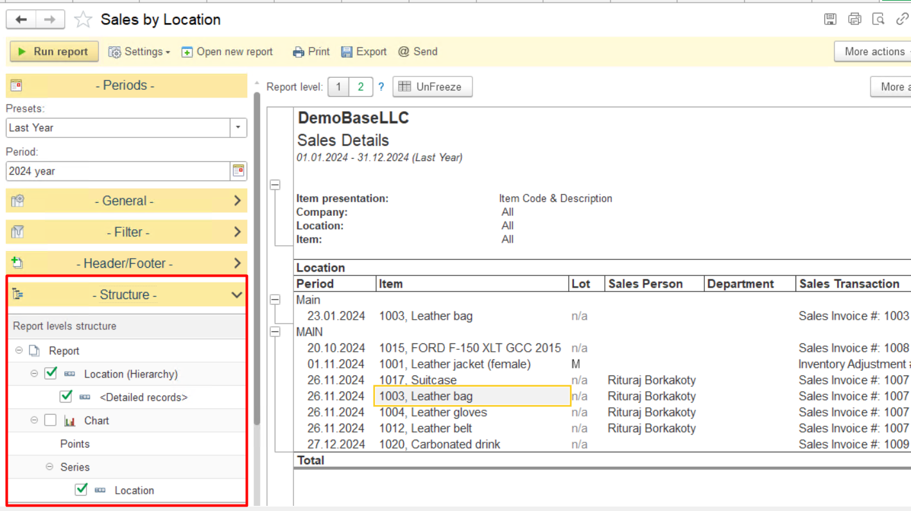
Flexible Reports
  Structure menu in the Settings panel, allowing users to easily customize report columns and report details from the report’s default options.

Slide 29
Flexible workflows
Purchases
Purchase order
Prepayment
Bill
Bill Payment
Purchase order
Items receipt
Bill
Bill Payment
Items receipt
Bill
Bill payment

Slide 30
Purchase orders
Purchases
Streamline ordering process
Clear documentation
Inventory Management
Audit trail
Notes:
1. Streamlined Ordering Process: Purchase orders provide a structured and standardized way to request goods or services, making the ordering process more efficient and reducing the chances of errors.
2. Clear Documentation: Purchase orders serve as a legal document that outlines the terms and conditions of the purchase, including pricing, quantities, delivery dates, and payment terms. This helps to avoid misunderstandings and disputes between buyers and suppliers.
3. Budget Control: By using purchase orders, organizations can track their spending more effectively and ensure that purchases are within budget. This helps to prevent overspending and improve financial management.
4. Inventory Management: Purchase orders help businesses keep track of their inventory levels by providing a record of items ordered and received. This can help prevent stockouts and ensure that the right products are available when needed.
5. Supplier Relationships: Using purchase orders can help strengthen relationships with suppliers by providing clear expectations and reducing the likelihood of misunderstandings. This can lead to better communication, improved reliability, and potential discounts or preferential treatment from suppliers.
6. Audit Trail: Purchase orders create a paper trail that can be useful for auditing purposes, allowing businesses to track their purchasing activities and ensure compliance with internal controls and regulatory requirements.

Slide 31
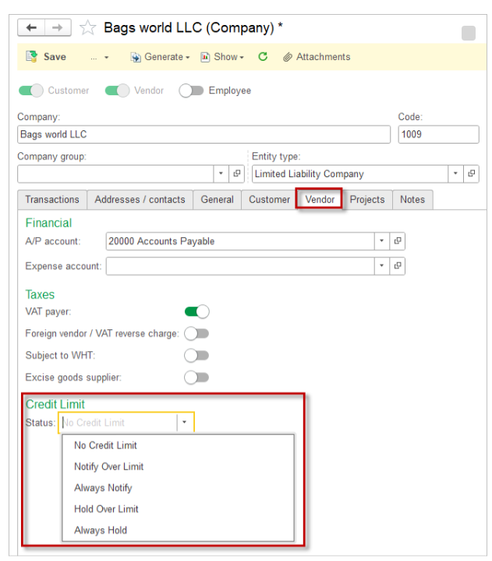
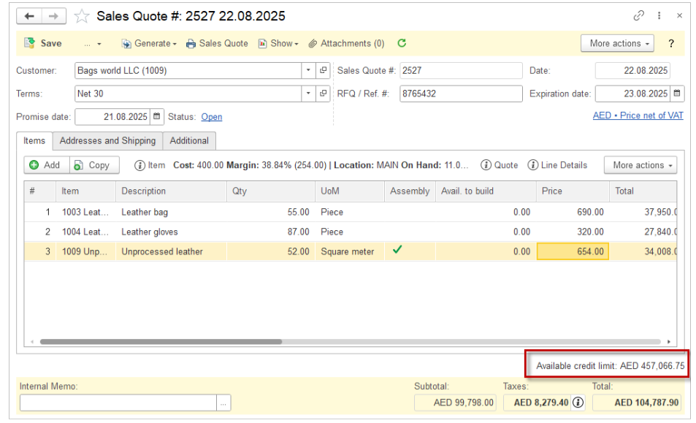
Credit Limit
Credit Limits for Customers and Vendors now available https://accountingsuite.io/docs/credit-limits/

Slide 32
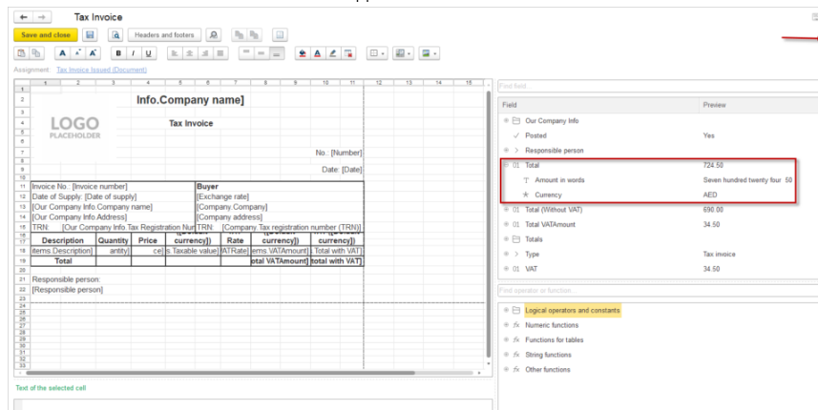

Print Forms
  Signature stamp can be added on a print form
  Users can now easily include a column sum in the print forms
  Product (Summary) attribute available on the Print from template
  Print forms templates for Bank Checks
Step by step guide:

Slide 33
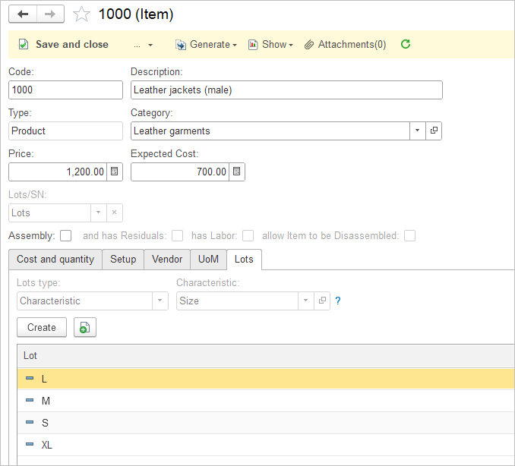
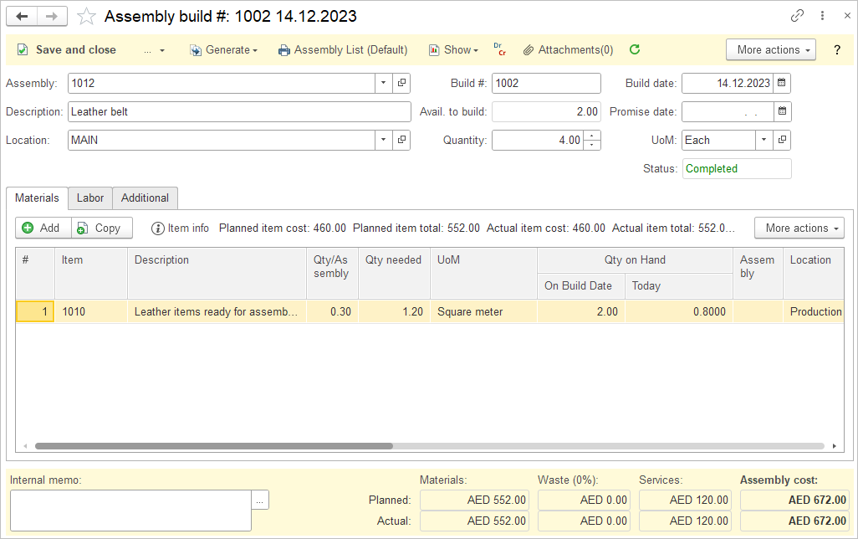

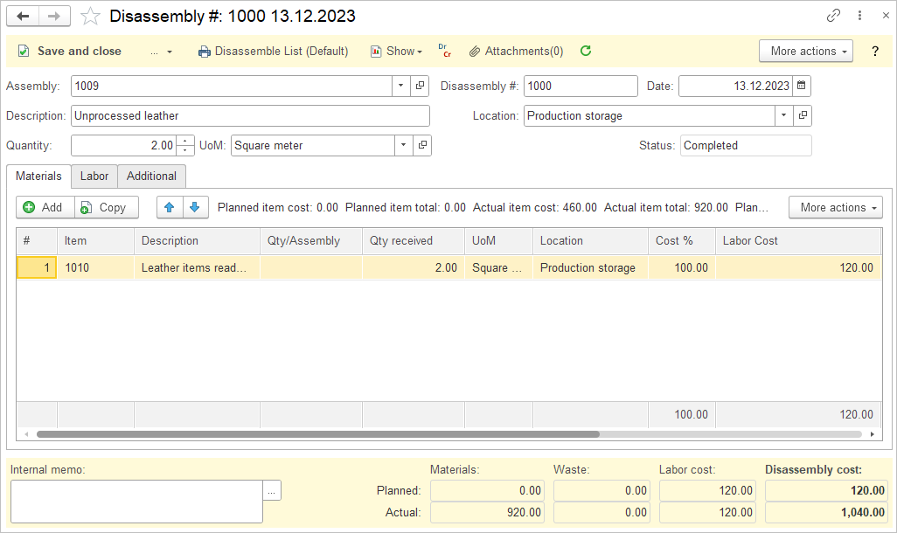
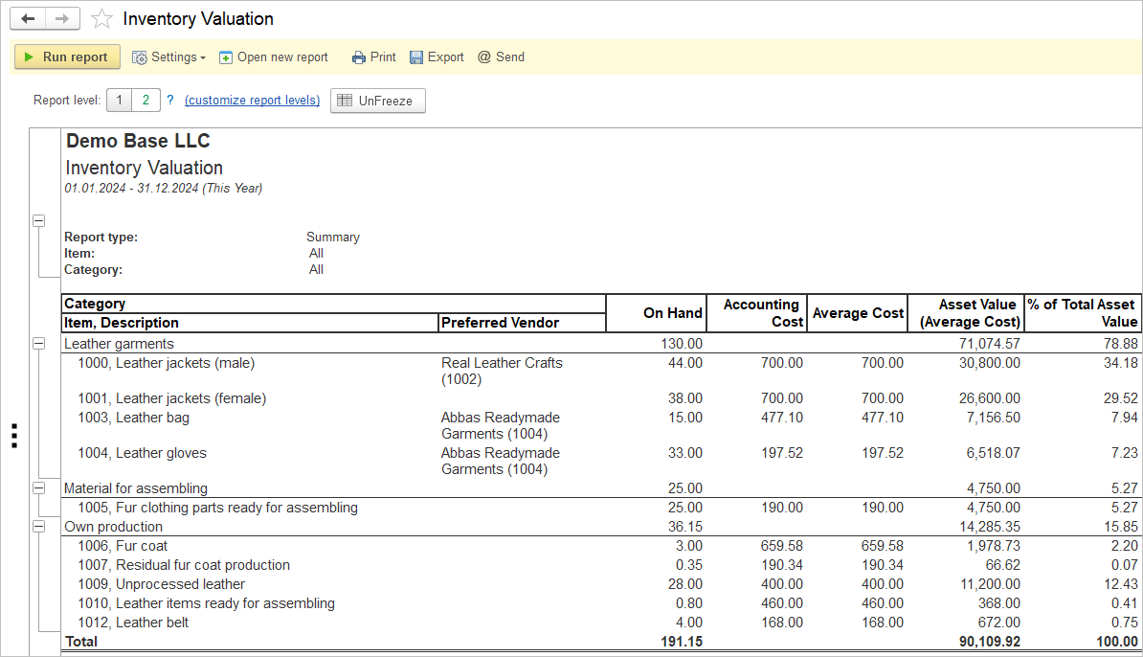
Inventory
Efficient management of stock levels
Detailed inventory, including:
Quality
Size / Color
Serial and Lot numbers
Units of measure
Multi-stage assembly and disassembly with labor and residuals
Landed cost allows to allocate any cost associated with freight, tax tariffs or anything else
Minimize stockouts and overstock

Slide 34
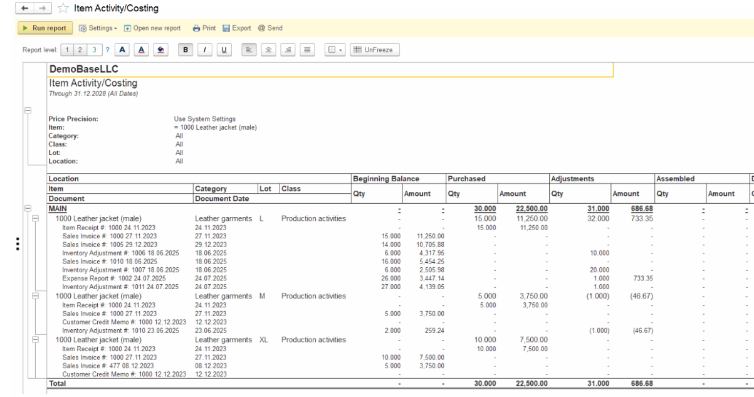
Advanced Reporting
Report has united both Item Costing and Inventory Unit Activity reports. The Structure of the report allows to check Sales Amount, Gross Profit, Gross Margin there

Slide 35

Projects & Time
Stay on track, stay on budget, stay successful
Customized breakdown of financial results
Enhance decision-making
Improved transparency
Track time for accurate invoicing
Control cost and prevent budget overruns
Resource
allocation

Slide 36
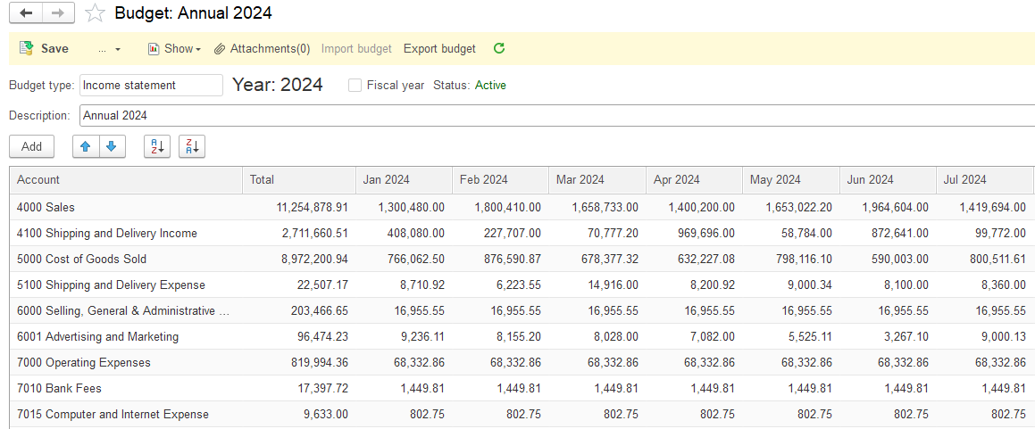
Budgeting
Confidence in the changing environment
Set financial goals
Track the expenses
Prioritize the spendings
Compare actual result to budget
Gain control over your finance

Slide 37

Bank
Control over your money
Multiple currencies
Cash in- and outflows
Automatic set-off of the liability
Import Bank Transactions (CSV/XLS)
Bank reconciliation
Cashflow report

Slide 38
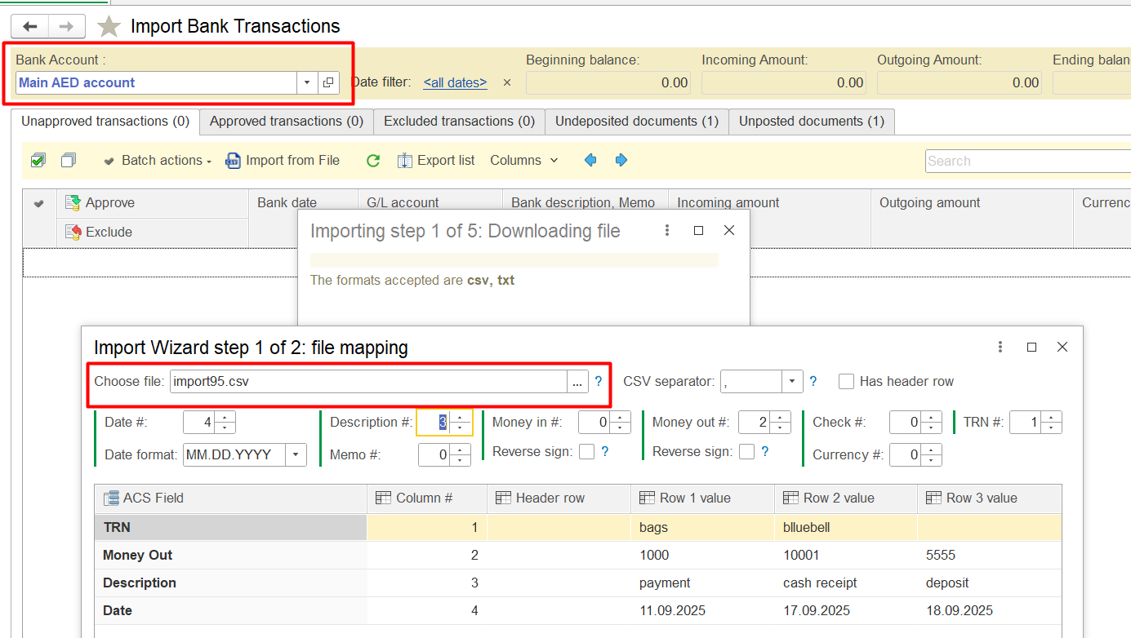
Import Bank Transactions (CSV/XLS)

Slide 39
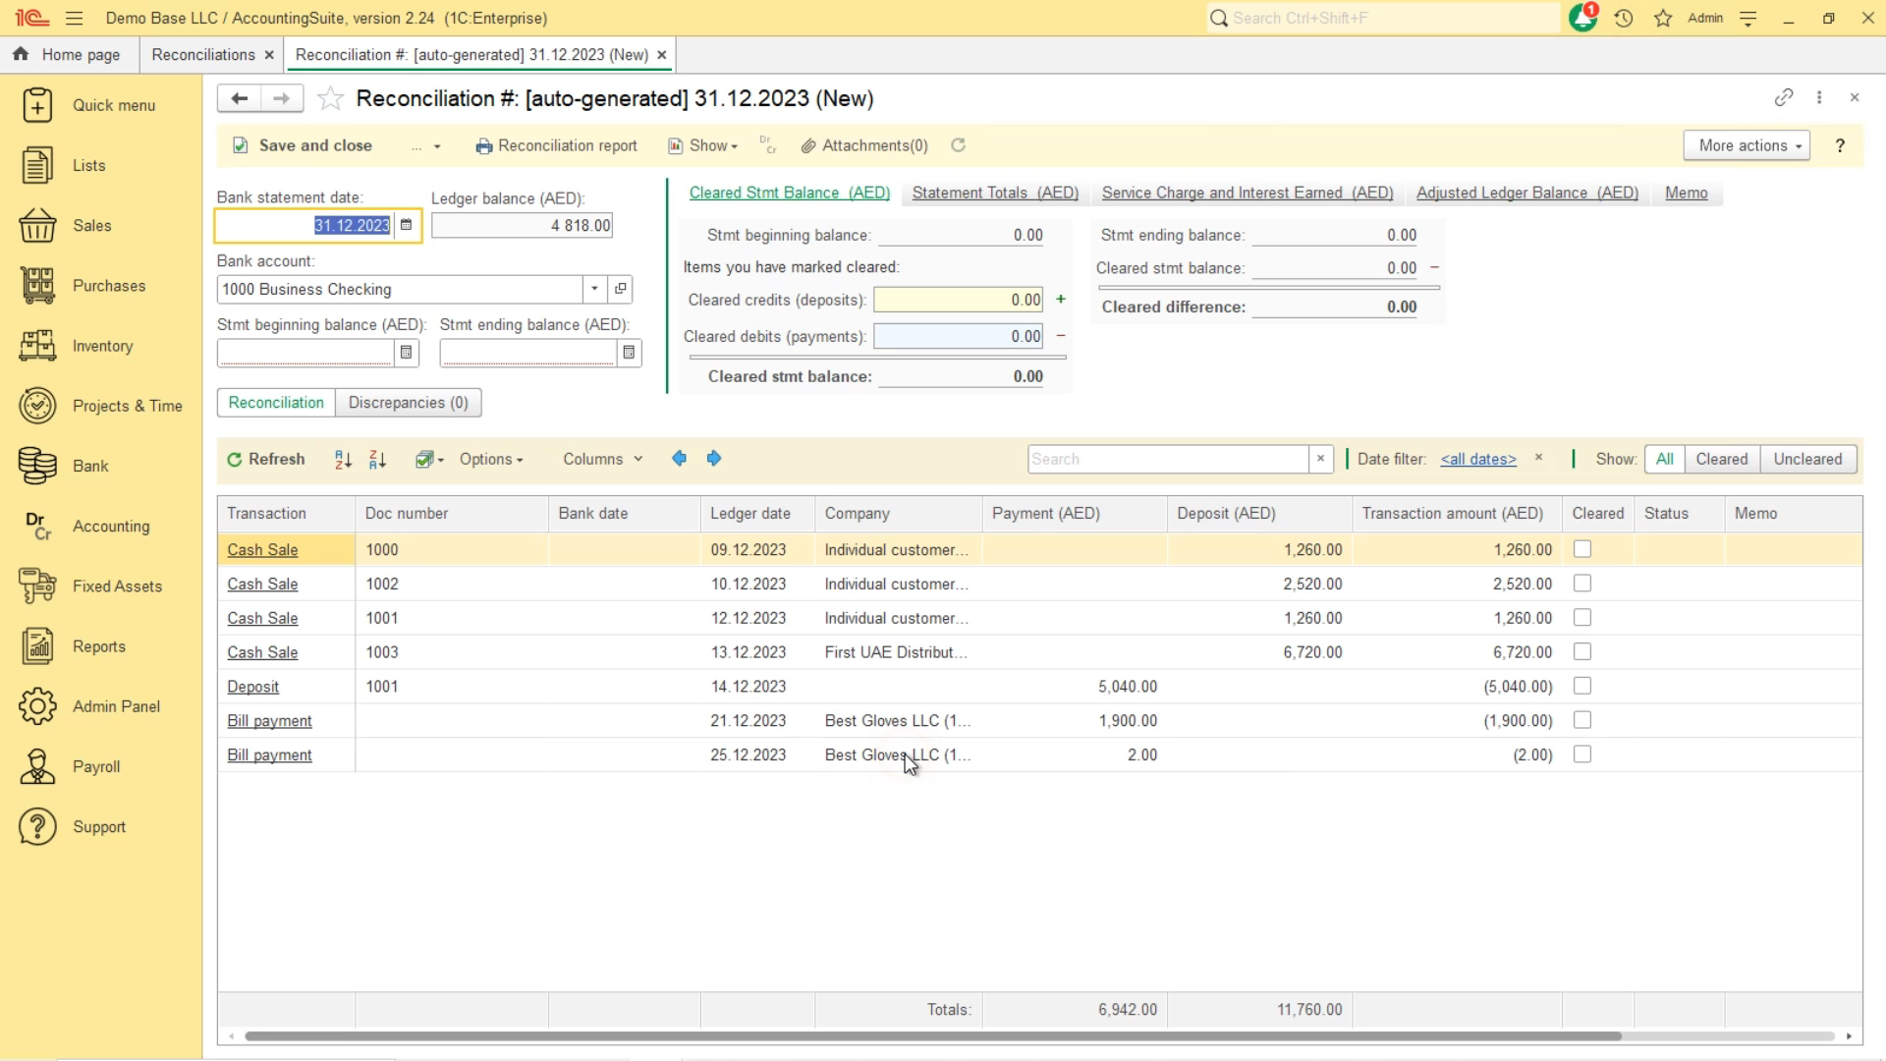

Slide 40
Taxes - overview
Common settings for taxes
Settings in the Tax:
Rate
Calculation base
Applicable date (From/to)
VAT
Excise
Withholding Tax
Levies
G/L accounts for each tax set in the Accounting settings

Slide 41
Taxes - overview
Specific settings for taxes
VAT
Default VAT rate
Prices to include VAT or be net of VAT
Withholding Tax
Upon invoicing / upon payment

Slide 42
Taxes - overview
Item tax parameters
Item
Tax group
Applicable taxes
Tax rate
Tax calculation base

Slide 43


Asset management
Fixed assets, intangible assets, prepaid expenses, low value assets
Acquisition
Depreciation / Amortization
Revaluation / Improvements
Disposal

Slide 44

Payroll
Calculate and account for your employees’ salary and taxes
Flexible earnings and deduction
Personal Income Tax
Social insurance obligations
Adjusted business calendar
In-built overpayment check

Slide 45
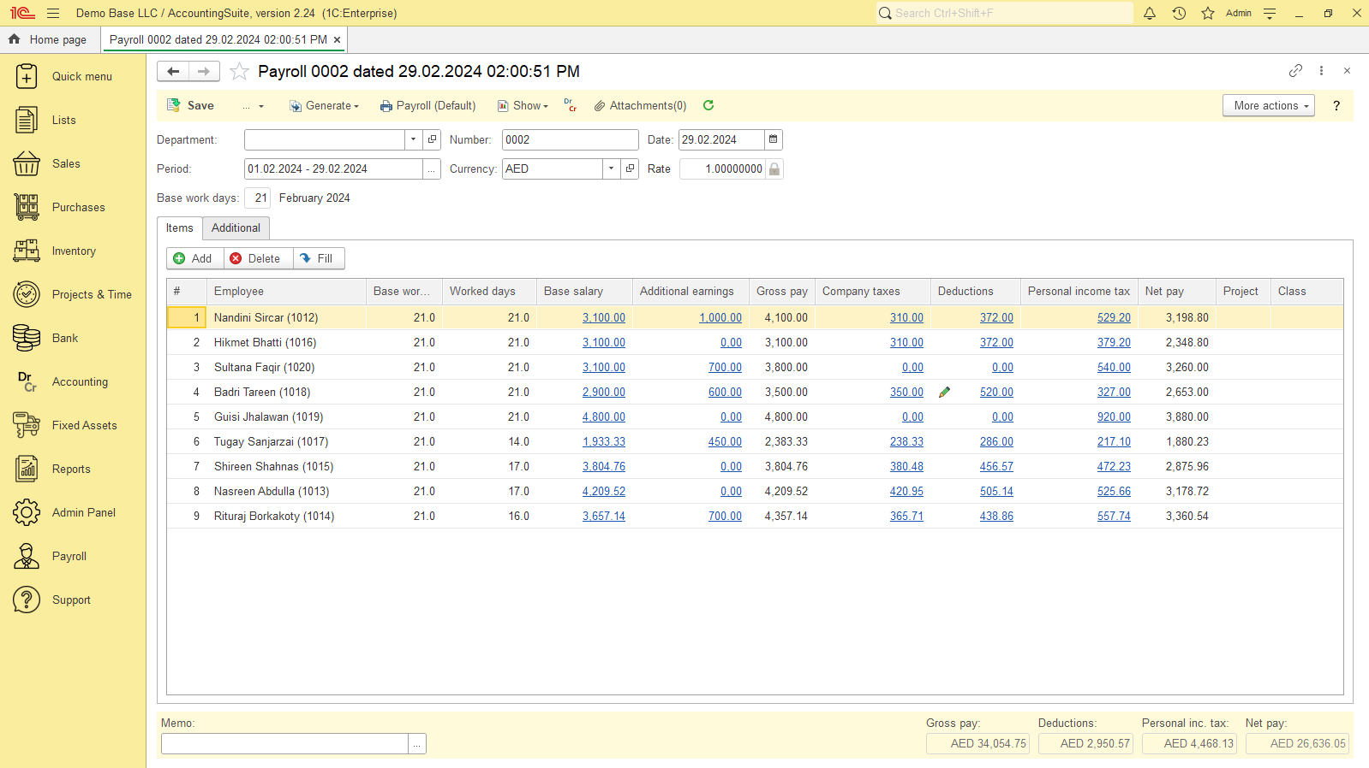

Slide 46

Customized extensions
Tailored Solutions for Your Accounting Needs
Software integrations
Complex reports
Workflow automation
Advanced analytics

Slide 47
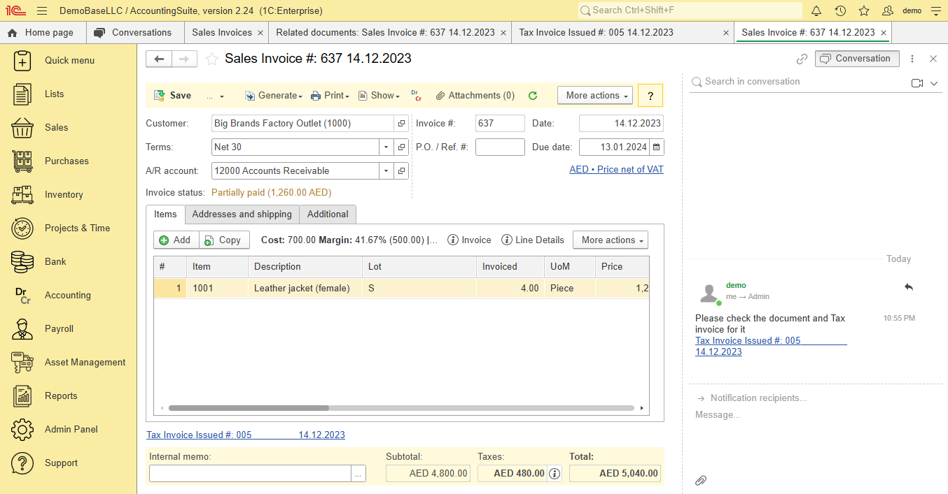
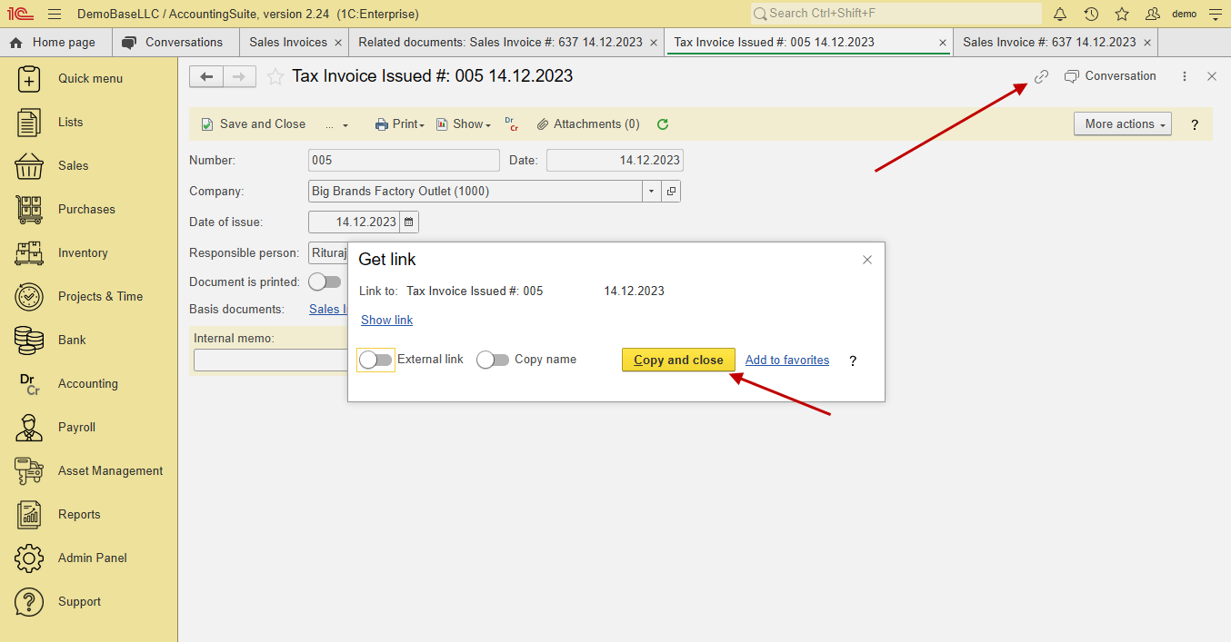
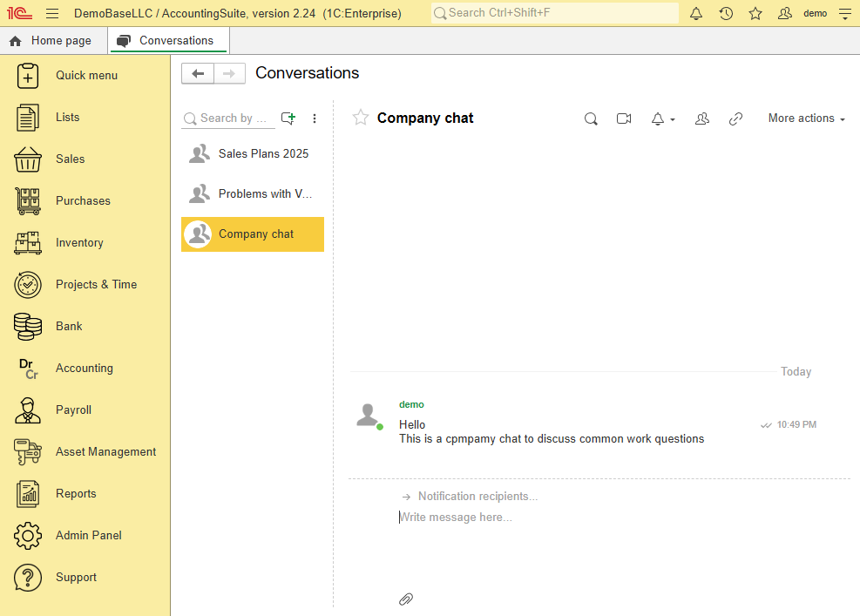
Collaboration system
Video calls + Sharing screen
Use links in document’s chats

Slide 48
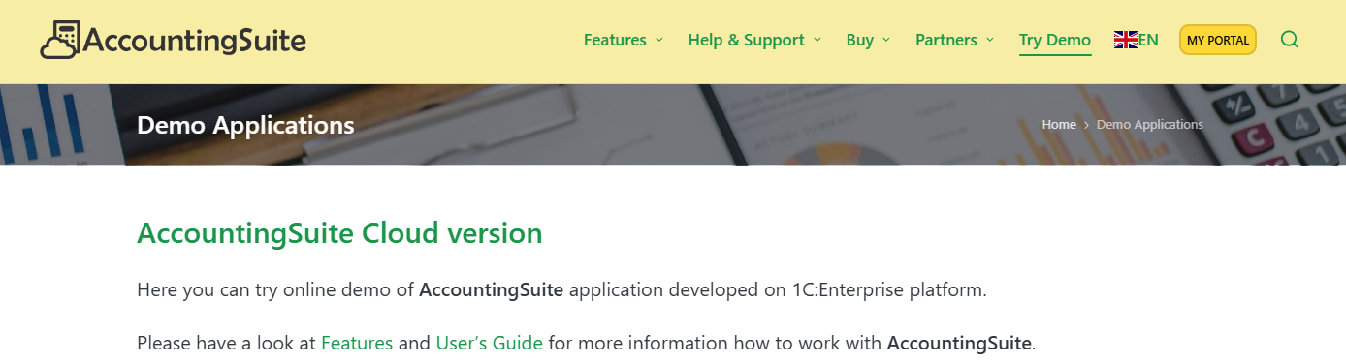
First steps with AccountingSuite
To start using our AccountingSuite, you need to register on our website AccountingSuite.io
Get a Trial Cloud version and start working immediately with your company data
The database can later be transferred to the On-premises version or the subscription can be extended for permanent use
On-premises users receive updates to their AccountingSuite version in their Portal Account and can check their subscription status
Try Demo link allows you to work with AccountingSuite demo base without registration to check the capabilities of the system and understand how well it covers your accounting needs

Slide 49


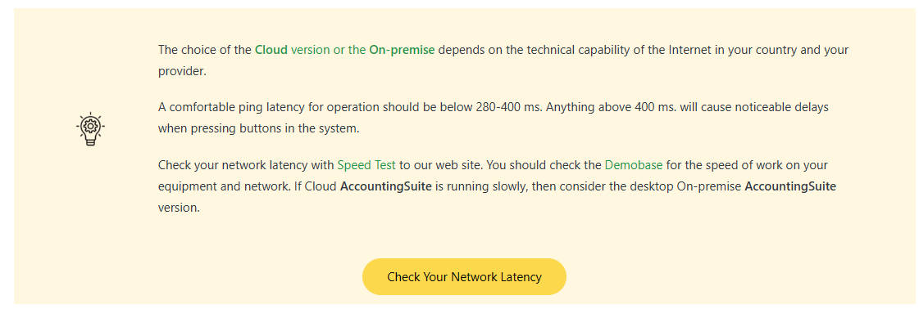
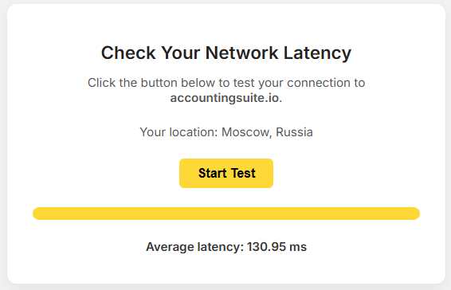
ON-PREMISE VS CLOUD
See more https://accountingsuite.io/features/on-premise-vs-cloud-version/
ON – PREMISE
Full control over data and infrastructure
Requires installation and maintenance of software on local servers
Suitable for organizations with strict data privacy and security requirements
Performs without Internet access
CLOUD
Hosted on remote servers, accessible via an Internet connection
Lower upfront costs as there is no need for hardware or software purchases
Enables remote access and collaboration from any location with stable Internet access
Are you ready for Cloud?
Please use Demobase and Trial Cloud for test Internet speed with AccountingSuite
Use Try Demo – Check Your Network Latency to check ping time (less 300 ms will be good)

Slide 50
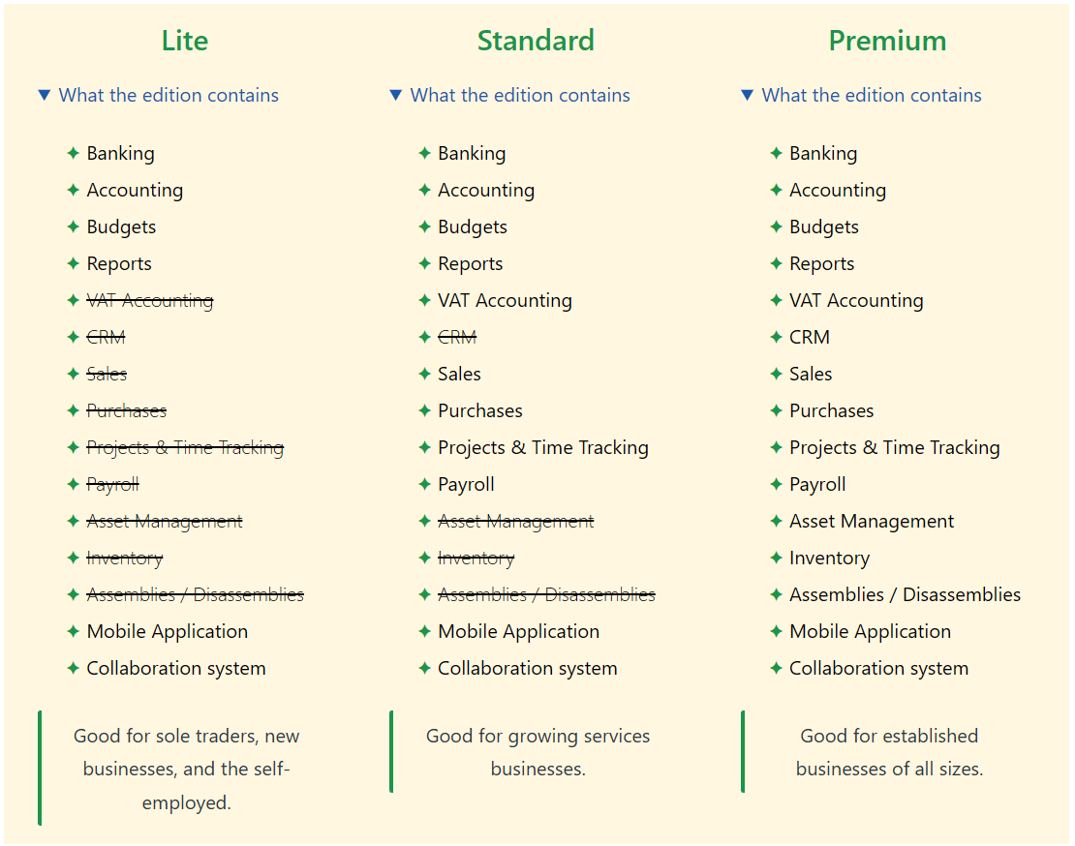
Cloud Editions
You can easily start with just one user and Lite Edition and add more options and users as your business grows

Slide 51
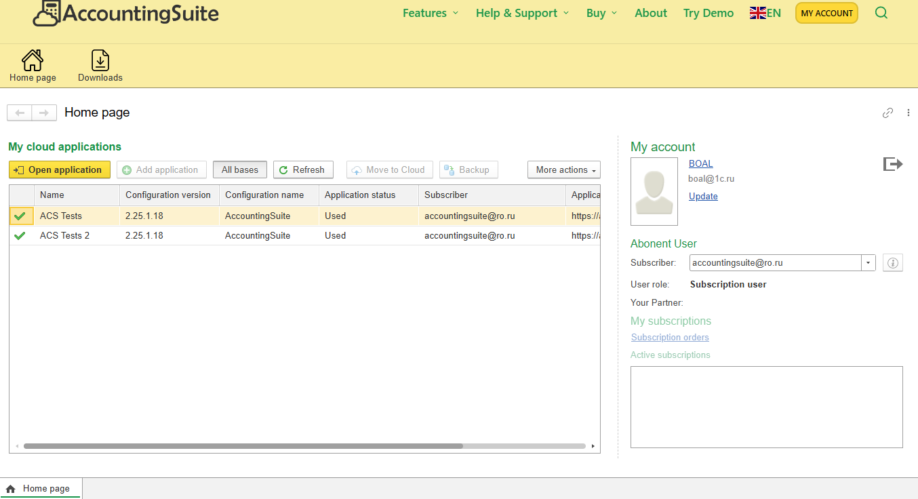
Standard user
The user to work in the database. There are no advanced features or subscription management.

Slide 52
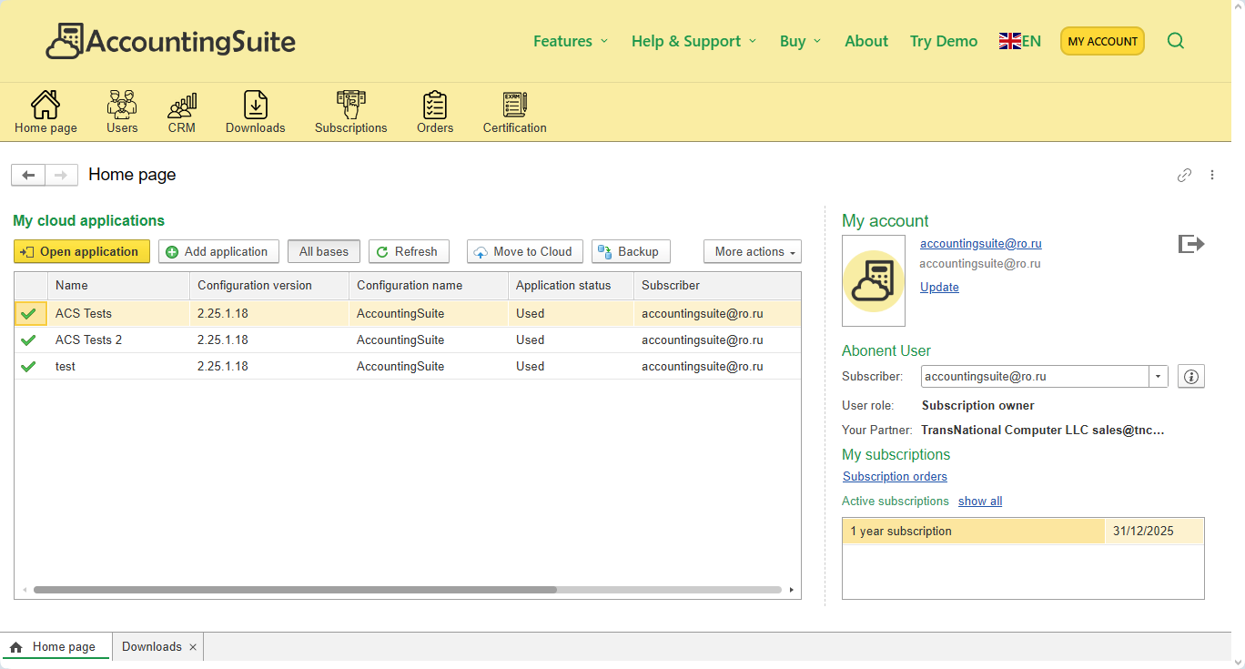
Partner user
Full control over subscription, users, databases

Slide 53
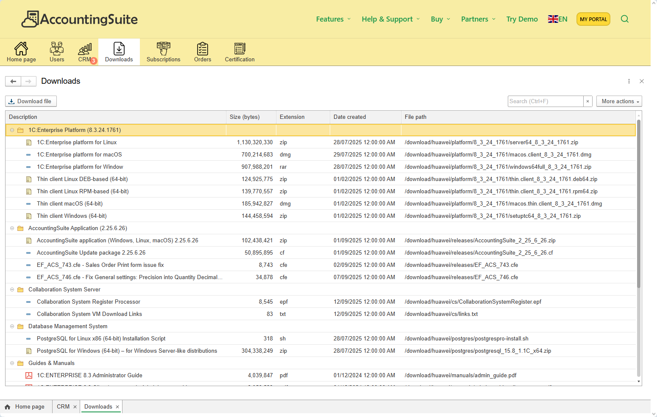
Downloads
1C Thin client and PDF User’s Guide – for Cloud
Server and files for On-premise

Slide 54
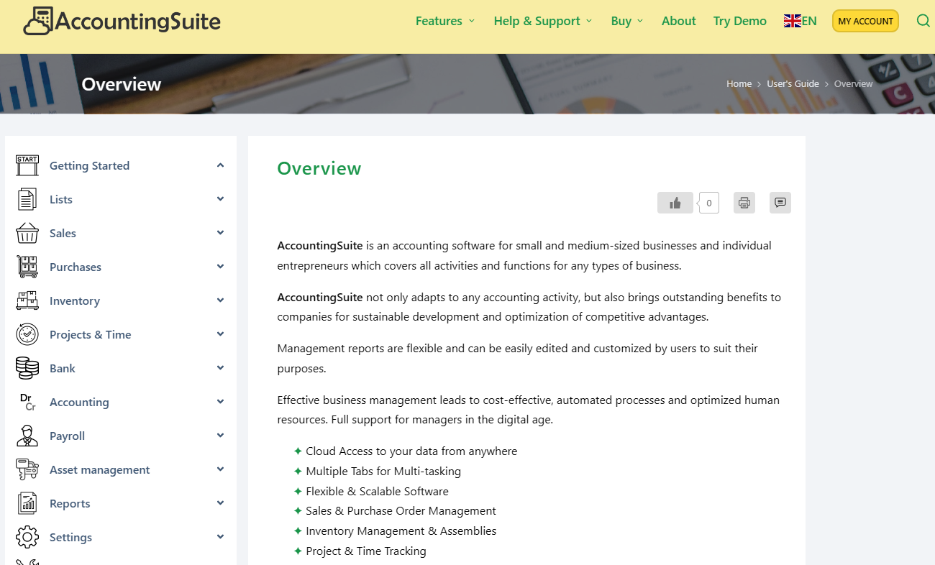
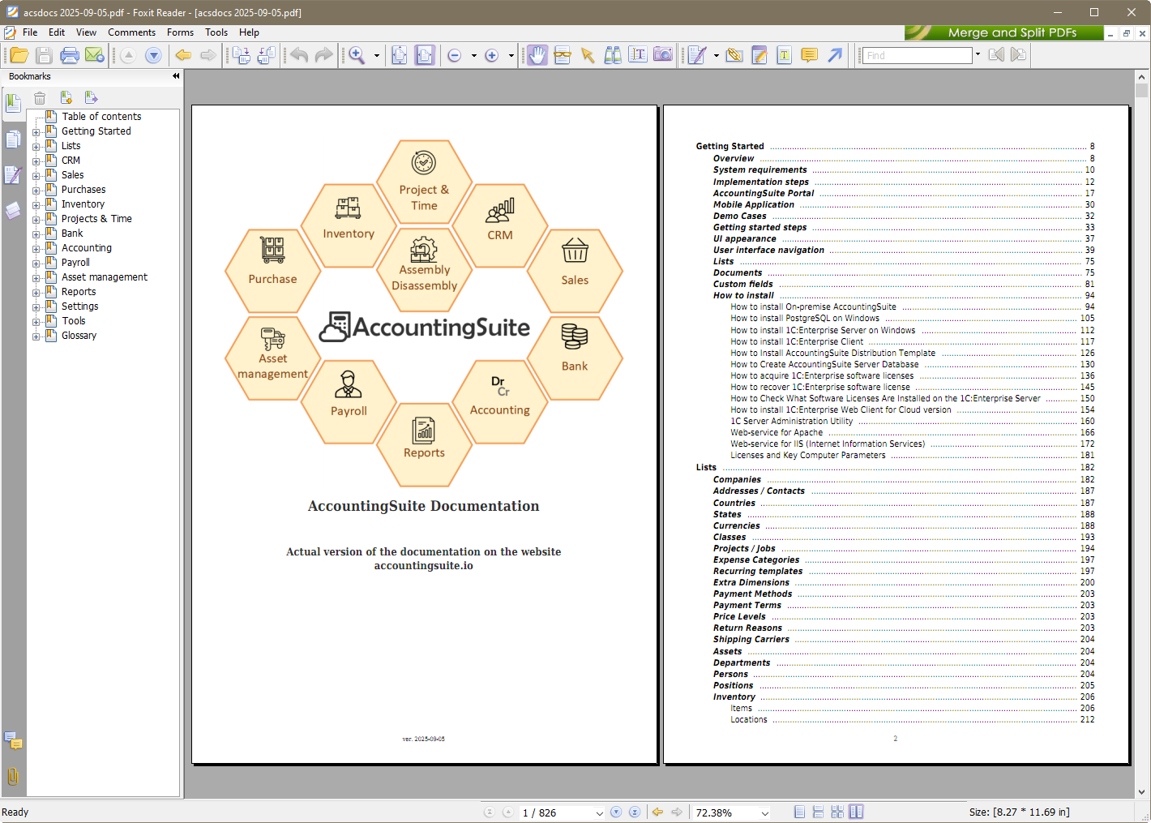
The AI Assistant helps to read the documentation
The documentation is in PDF 820+ pages. It is an AI knowledge base

Slide 55
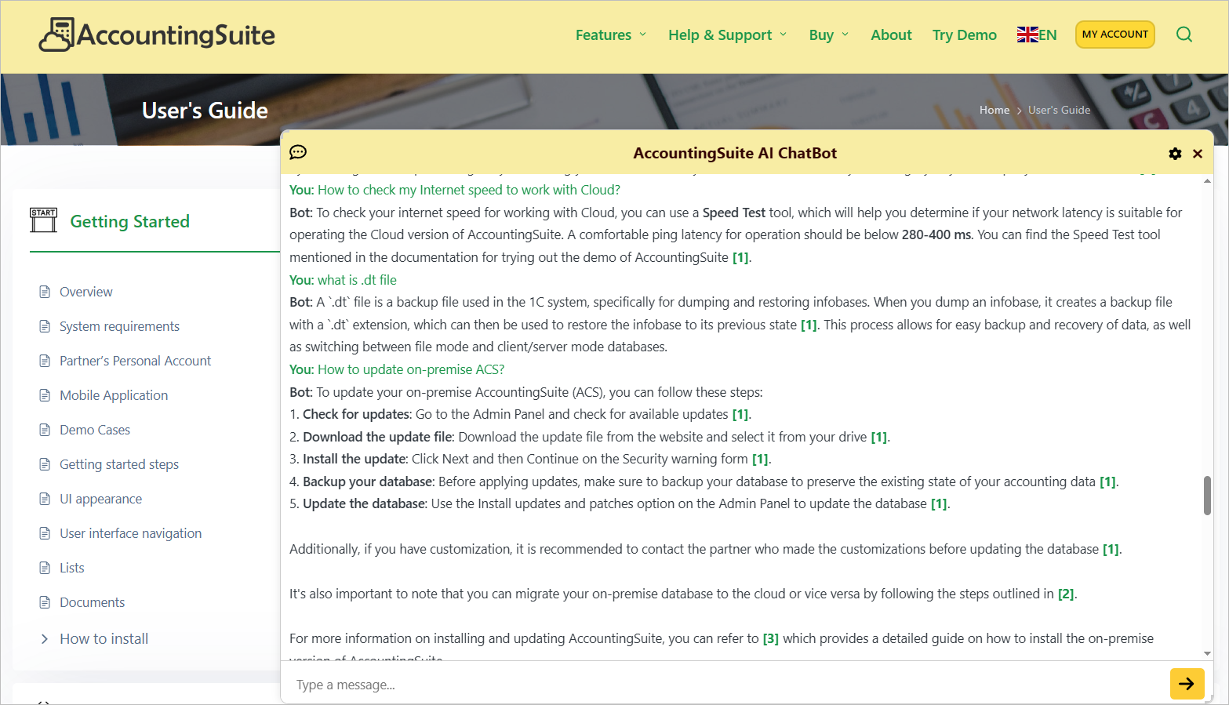
Ask AI help about AccountingSuite
Try AI at work on AccountingSuite.io
A quick and clear answer to any question. Good onboarding with help of AI.

Slide 56
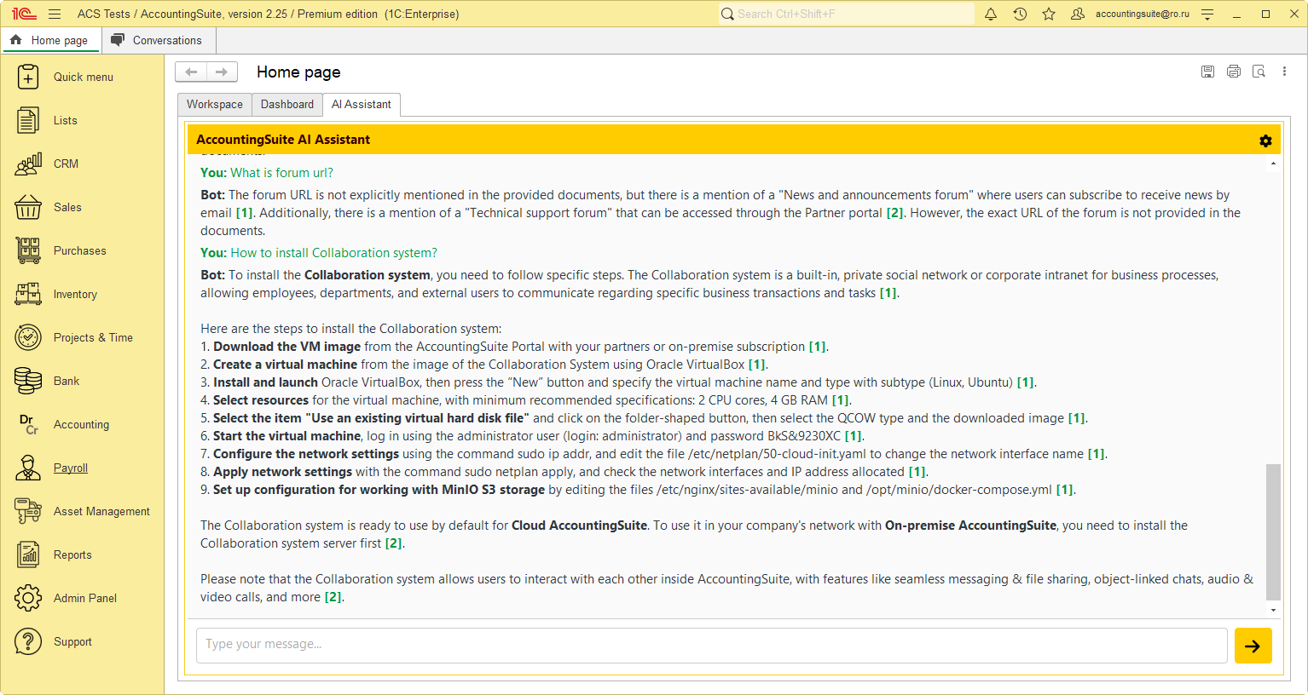
ИИ
Built the AI directly into
On-Premise AccountingSuite

Slide 57
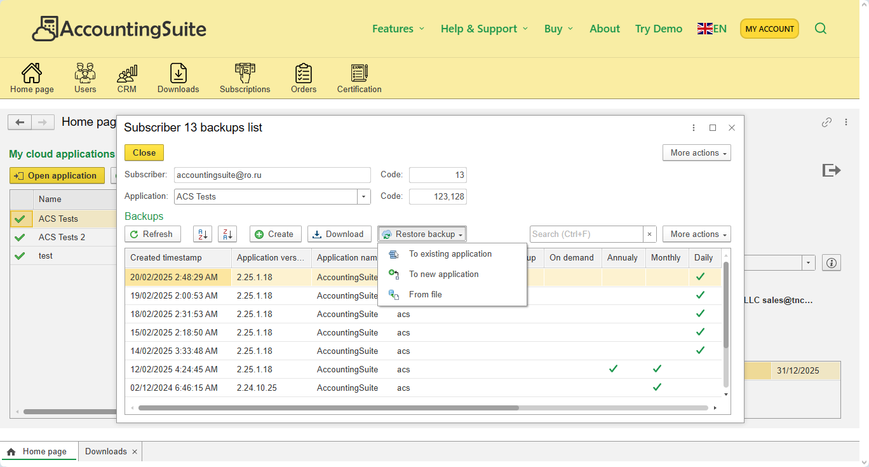
Backup and Restore
Backup management allows move to On-premise or to Cloud

Slide 58
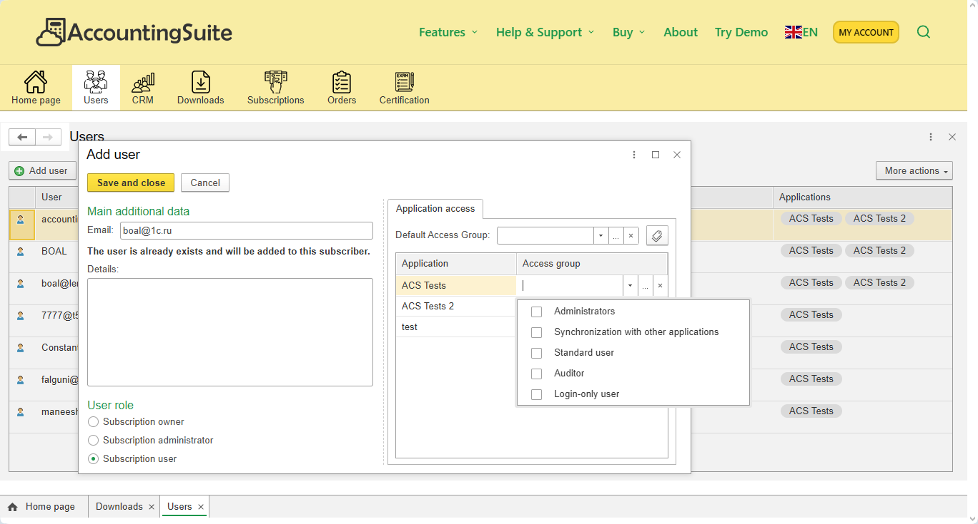
Adding users
Add user for databases with user’s rights
Any user – you can be added to the client’s database or their to yours

Slide 59
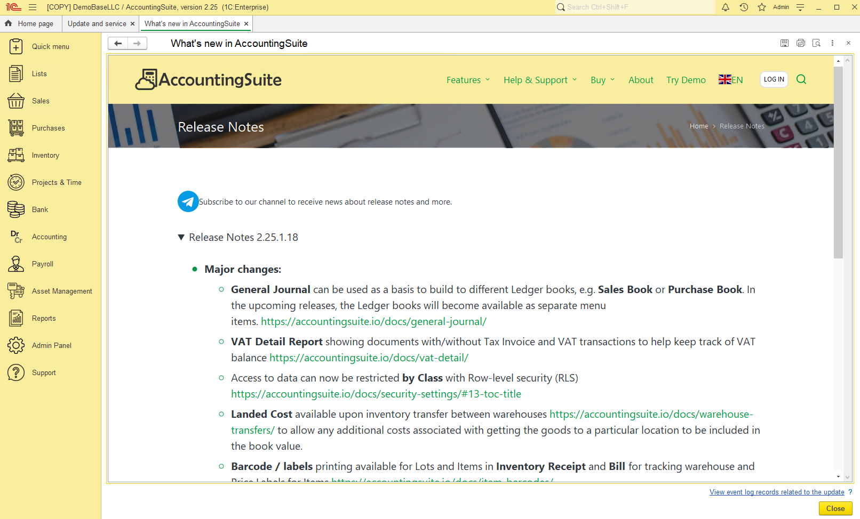
Release Notes
https://accountingsuite.io/release-notes/
Now will be opened after updates inside the system

Slide 60
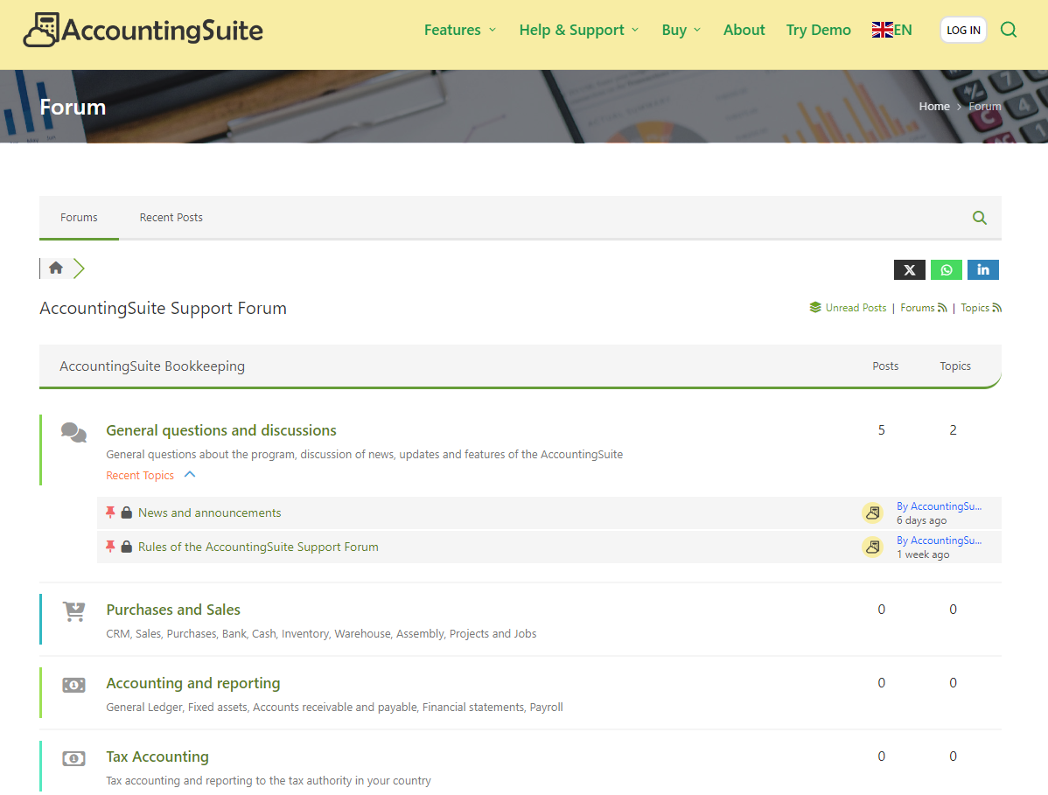
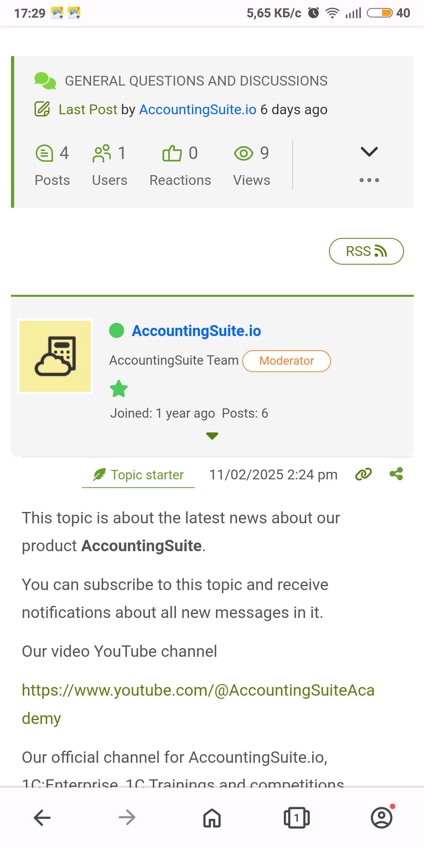
Support forum
Works via Smartphones

Slide 61
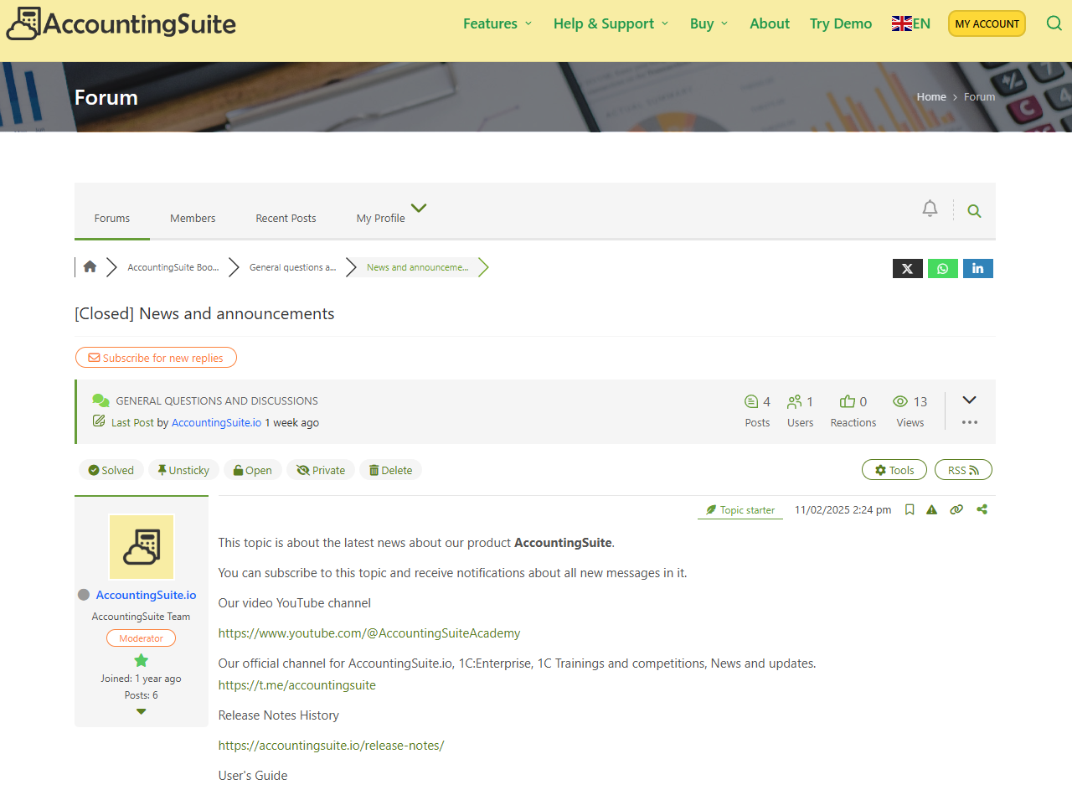
Subscribe news forum topic
https://accountingsuite.io/forum/
Subscribing to RSS feeds
To keep up to date with all the news via email

Slide 62
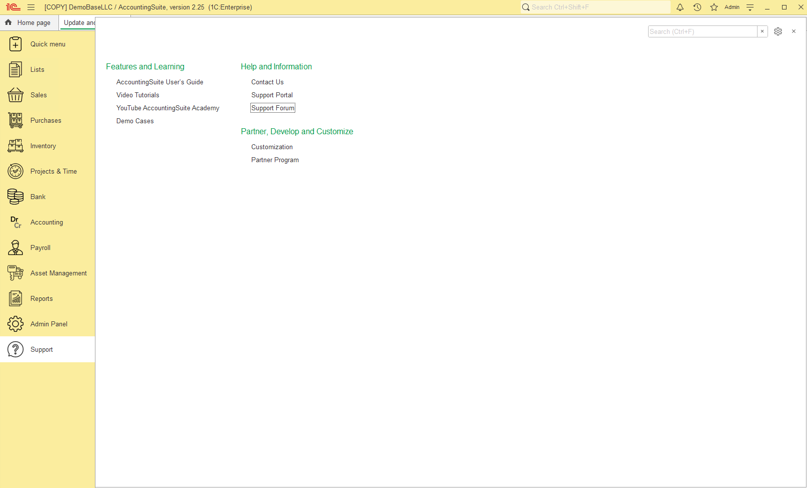
Support
Support tab inside the system

Slide 63
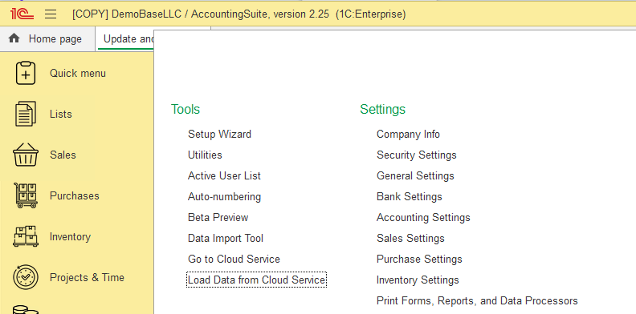
How to start AccountingSuite implementation?
If the customer has purchased the On-premise version, start with using Cloud AccountingSuite to create prototype of client's company.
It is easy to set up database sharing with partner’s and client’s users.
There is no need to involve the client's administrator to access client's network.
Quick results and start of work. Get additional time to study on-premise administration.
Then prototype will be ready, we will transfer the backup from the cloud to the on-premise in client's network.
On-premise and Cloud are fully compatible!

Slide 64
How to replicate the database with settings for other companies?
Task: mass implementations of AccountingSuite for different countries or replication within the company for branches
You can set up the database with a prototype for the country/company data with predefined
  Chart of Accounts and default General Ledger Settings
  Address Classifiers
  Taxes Rates and Tax Agents
  Payroll Settings
  Print Form Templates
  Local Reporting Variants
Then save this database (make a backup of it)
And then deploy it to other clients for you country from backup
And later upload additional client’s data with Data Import Tool

Slide 65
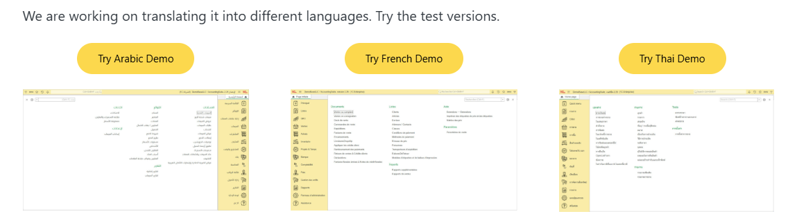
UI Localization
https://accountingsuite.io/demobase/

Slide 66

Thai UI

Slide 67

Arabic UI

Slide 68

French UI

Slide 69



What’s next?
Visit our website
Try out our free
demo base
Download the
mobile application
Read the user guide

Slide 70


Telegram Channel
Our official channel for AccountingSuite.io, 1C:Enterprise, 1C Trainings and competitions, News and updates.
https://t.me/accountingsuite

Slide 71
You can do accounting easier with AccountingSuite

